Slide 1
Using ArcGIS Online
for Emergency Management
Notes:
Introduction –
Darlene Tran
Senior Geomatics Officer at the Department of Public Safety Canada, since 2020,
Worked with Geomatics in Emergency Management since 2015
Today, I will be talking about how my team uses ArcGIS Online to coordinate and share information with emergency managers in Canada

Slide 2
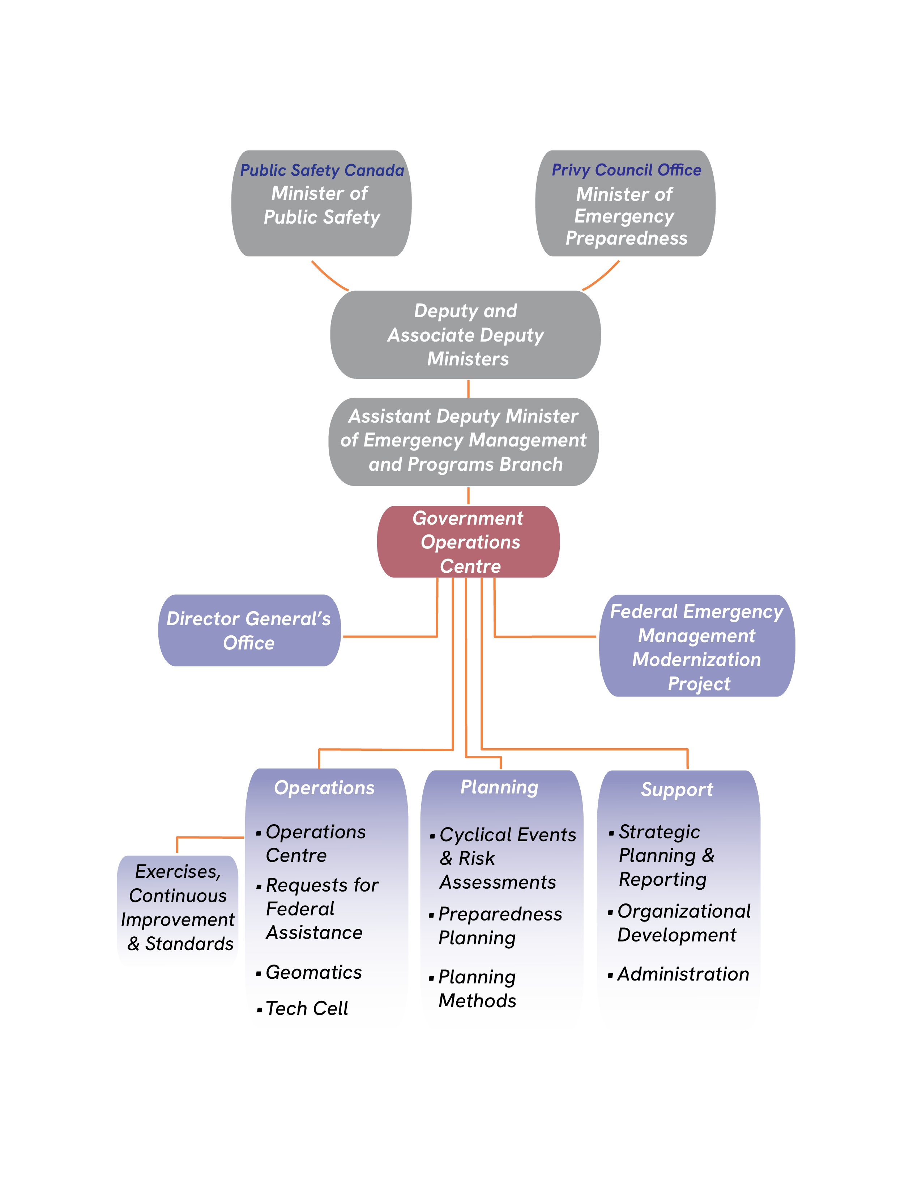
Public Safety Canada
Public Safety Canada
The department of Public Safety Canada was created in 2003 to ensure coordination across all federal departments and agencies responsible for national security and the safety of Canadians.
Our mandate is to keep Canadians safe from a range of risks such as natural disasters, crime and terrorism.
Our mission is to build a safe and resilient Canada.
Our vision is to, through outstanding leadership, achieve a safe and secure Canada and strong and resilient communities.
We are responsible for emergency management and national security are the safety of Canadians
Notes:
Who we are
Public Safety Canada was established in 2003 to ensure coordination across all federal departments and agencies responsible for national security and the safety of Canadians.
Our mandate is to keep Canadians safe from a range of risks such as natural disasters, crime and terrorism.
We are responsible for emergency management and national security are the safety of Canadians

Slide 3
Government Operations Centre
What is the GOC?
The GOC is a government asset housed in the department of Public Safety Canada. Its role is to convene, collaborate, coordinate, and communicate.
It is a service delivery platform designed to support national emergency management response to events and coordinate federal preparedness through planning, exercising, and monitoring.
Notes:
The Government Operations Centre, commonly known as the GOC, is a key component of Public Safety Canada.
The GOC’s primary purpose is to provide situational awareness, coordination, and decision making support during crisis, emergencies, and national security incidents.
During emergencies, the GOC acts as the central hub for sharing critical information, coordinating resources, and facilitating communication among all levels of government
The GOC works closely with federal, provincial, territorial, and municipal partners, as well as international organizations and the private sector
These collaborative efforts strengthen Canada’s ability to effectively respond to emergencies and ensure the safety and security of it’s citizens

Slide 4
Geomatics Section
Our Mandate
Enhance the Government Operations Centre’s (GOC) ability to provide strategic coordination and advice on current and upcoming events through geomatics products, information and services
Contribute to the GOC’s situational awareness capabilities by supplying geographic perspective of events
Support Public Safety Canada and other Government of Canada partners that have limited or no geomatics capabilities
Engage Provinces/Territories by coordinating the provision of federal geomatics services for Emergency Management (EM) related issues
Notes:
The Geomatics Section enhances the GOC’s ability to provide strategic coordination and advice on current and upcoming events that have the potential to impact national interests through the provision of geomatics products, information and services.
The Geomatics Section contributes to the GOC’s situational awareness capabilities by supplying a geographic perspective of events with value-added information such as critical infrastructure locations and attributes.

Slide 5
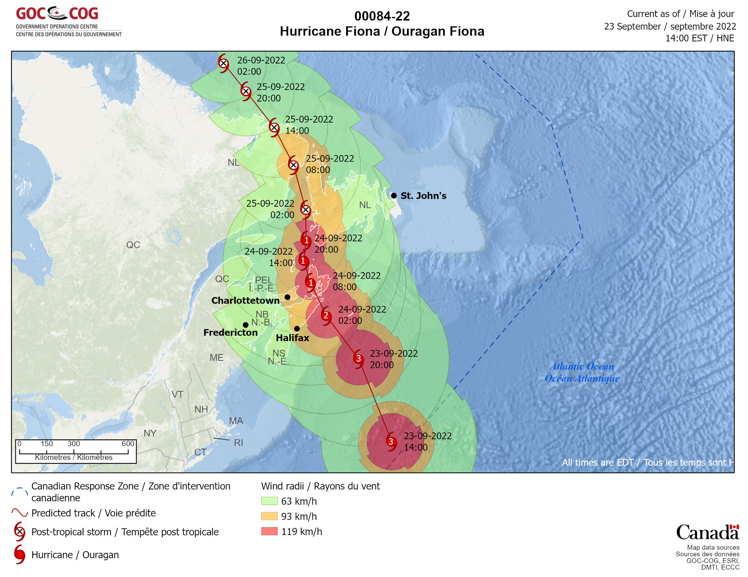
Hurricane Fiona
September 14 to September 28, 2022
Fiona made landfall near Whitehead, Nova Scotia, on the morning of September 24
Fiona impacted the four provinces of Atlantic Canada, as well as Quebec
Emergency managers wanted surveillance to support the recovery
The GOC Geomatics team coordinated with Transport Canada to receive imagery from the National Aerial Surveillance Program (NASP)
Notes:
Hurricane Fiona was a large, powerful, and destructive Category 4 Atlantic hurricane which was the costliest and most intense tropical or post-tropical cyclone to hit Canada on record. It was the sixth named storm, third hurricane and first major hurricane of the 2022 Atlantic hurricane season.
Fiona affected the four provinces of Atlantic Canada, as well as Quebec.^{[94][95][96]} The storm caused major flooding in Quebec's Magdalen Islands, southeastern New Brunswick, Prince Edward Island, northeastern Nova Scotia, and southern Newfoundland.^{[97]} Thousands of trees were knocked down and uprooted in Nova Scotia from Halifax eastward, as well as most of southeastern New Brunswick, most of P.E.I., and some parts in Newfoundland. At least 20 homes were damaged or destroyed in Newfoundland, primarily in Channel-Port aux Basques, with almost 200 people displaced.^{[99]}
There was an interest by emergency managers for surveillance to support the recovery post disaster.

Slide 6
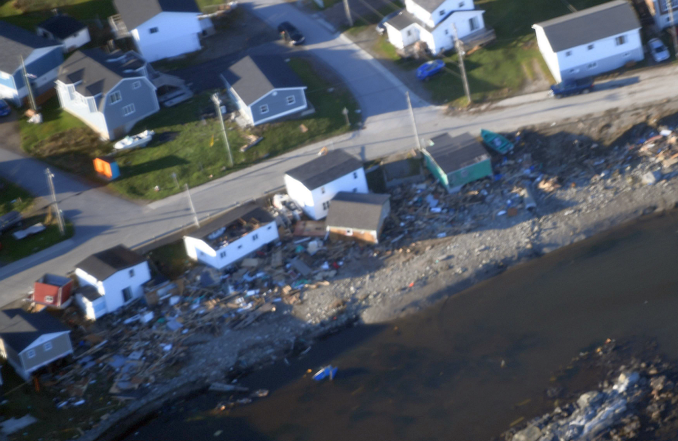
Hurricane Fiona
NASP image of damages in Port aux Basques, NL
Notes:
Our team coordinated with Transport Canada to collect images of the post disaster impacts,
Here is an example of post disaster damage imagery taken in Port Aux Basques, NL

Slide 7
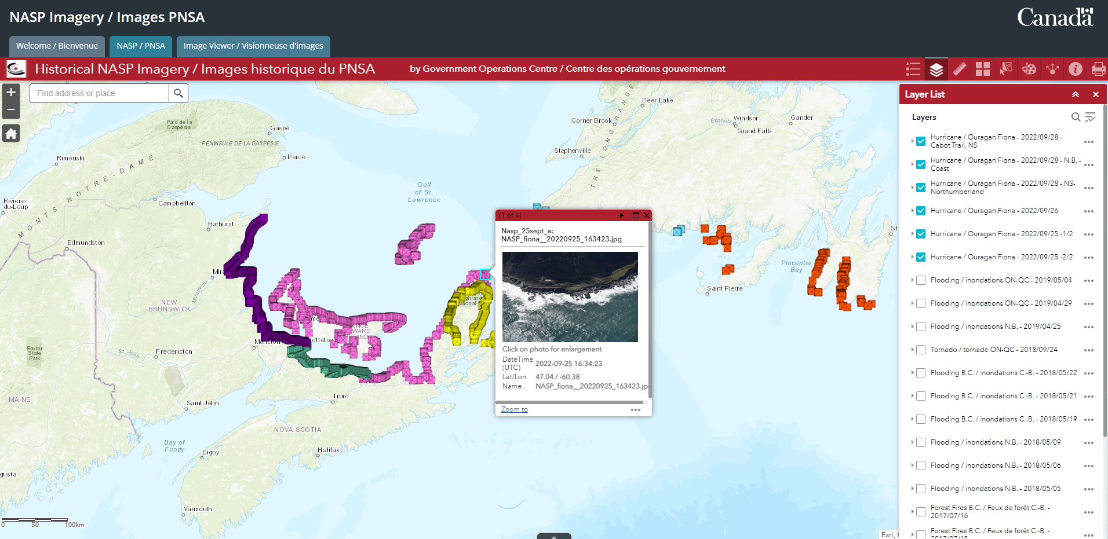
Hurricane Fiona
NASP Imagery Viewer
Notes:
When a request is made for aerial images through Transport Canada, we are sometimes provided with hundreds to thousands of images.
The challenge was collecting all the images and making them accessible for emergency managers in a consumable format
We were able to geocode and display all the images using a script and loaded them onto a web map. This application shows the flight path and allows emergency managers to easily navigate to where they would like to assess impacts.

Slide 8
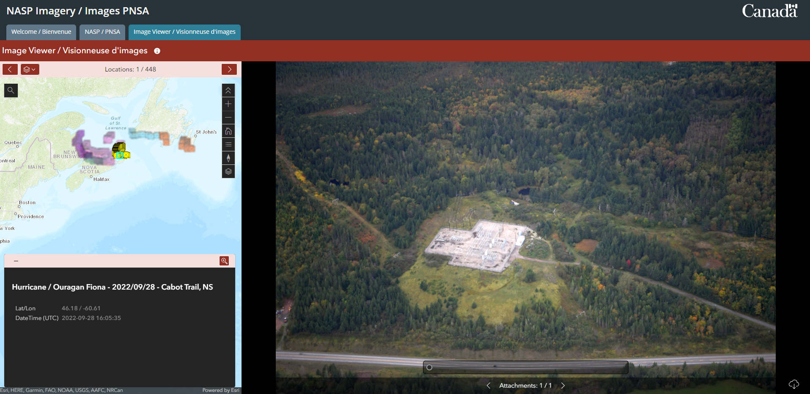
Hurricane Fiona
NASP Imagery Viewer
Notes:
Here is our Instant App to view all the images for the event.
This application allows the user to easily navigate through all the images from the flight path, as well as highlights which event and where the image is on the right.

Slide 9
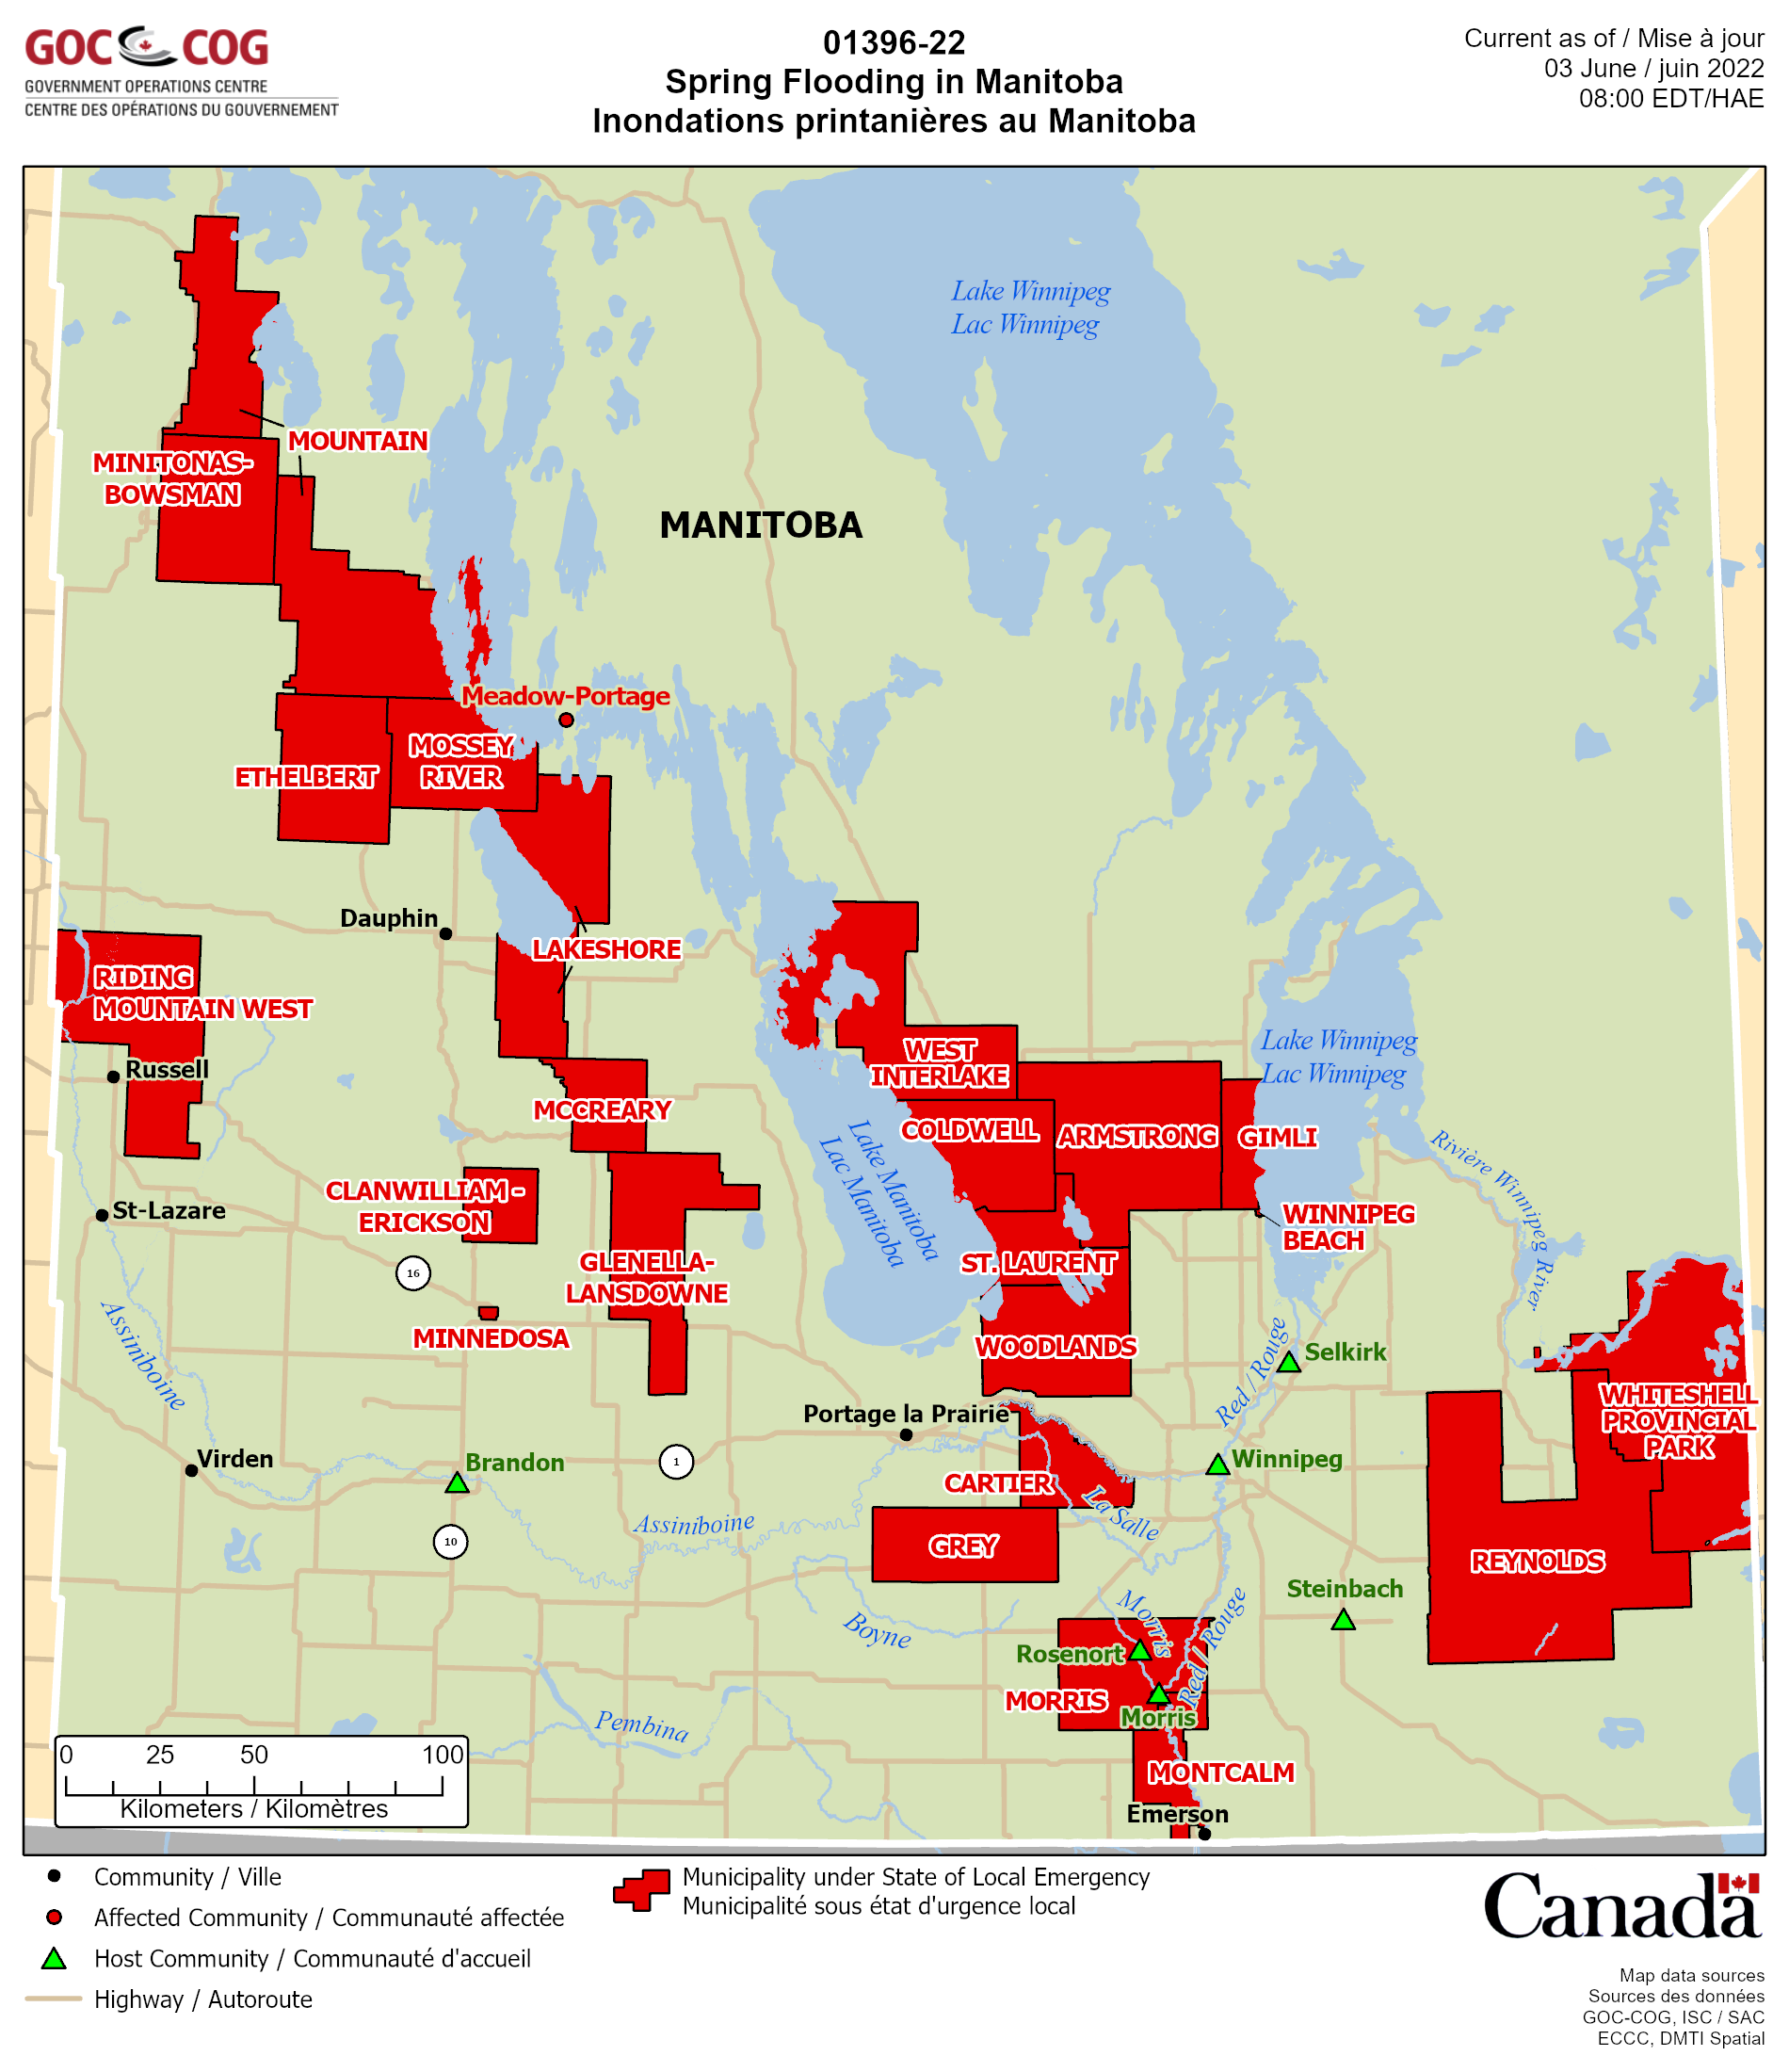
Flooding in Manitoba
Our team supports the Government of Manitoba’s Emergency Operations Centre (EMO) for their emergency management geomatics needs
In 2022, heavy rainfall and melting snow lead to significant floods across the province
Manitoba’s EMO would provide us with a list of their on-going State’s of Local Emergencies (SoLEs) by email for us to map throughout the flood season
Notes:
With this list, we would update our static maps, as well as update a live feature layer for a dashboard we developed for the EMO to use.
Some challenges we were faced with were that not all communities with SOLEs were at the same geographical level. We were required to use multiple layers in order to represent communities, first nations, parks, and districts.
As well, for each update, we had to cross reference the tables or emails to any existing SOLEs on the feature layers, which of course took some time. Since our team works at the federal level, we were also working on mapping floods for other provinces and territories at the same time.

Slide 10
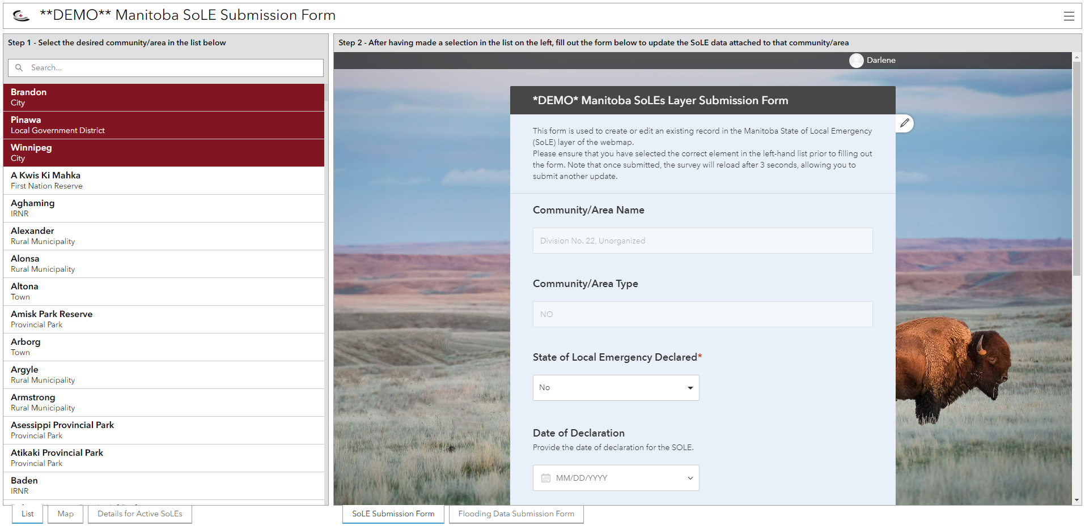
Flooding in Manitoba
State of Local Emergencies – Survey123
Notes:
This year, our team explored Survey123 and learned it could be used and designed for the EMO to update their SOLEs on their own. Their inputs into the Survey123 would live update their dashboard.
The survey was designed in a way such that all the relevant and necessary information was readily available for the EMO to navigate to the community names that required to be mapped.
We consolidated all the various administrative boundary layers to be available to select in the survey, making it easier to find in a single list.
The survey also allowed for them to include the expiry date, and with appropriate filters, would toggle those features off once it met the expiration date.
Even by giving the EMO more control over their data, we were still able to monitor all updates to the dashboard. For any updates, we were able to set up email alerts to the MB EMO email as well as our own through Webhooks.

Slide 11
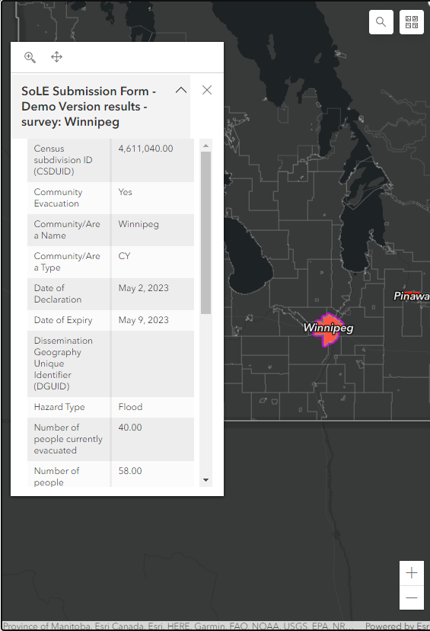
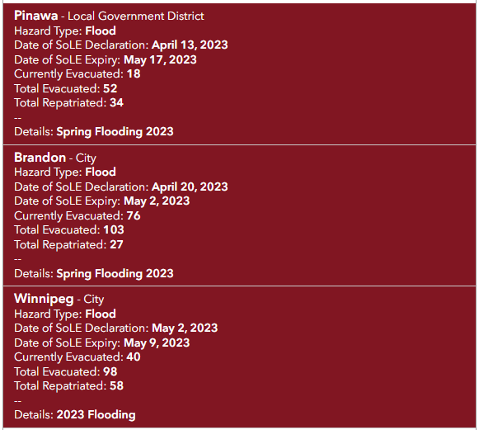
Flooding in Manitoba
State of Local Emergencies – Survey123
Notes:
In the same application, the EMO was able to navigate their data, as well as other relevant flood layers, on a web map embedded into the dashboard.

Slide 12
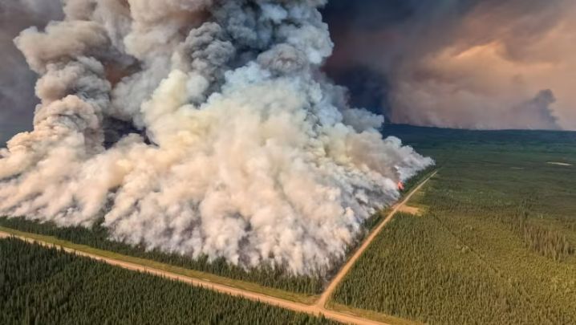
Wildfires across Canada
We are currently in our worst year in history for wildfires in Canada
As of July 8, 3,519 fires had burned 8,928,358 hectares (22,062,453 acres)
Smoke emitted from the wildfires has caused air quality alerts and evacuations in Canada and the United States
By late June it had crossed the Atlantic to reach Europe
Donnie Creek Wildfire, British Columbia
Spans more than 5,715 sq km (~2206sq miles)
Notes:
On June 27th, Canada surpassed it’s known historic record for total area burned in one season was 7.6 million hectares in 1989.
The 4 largest fires burning (BC, NT, SK, QC) total more than 10,400 sqM. That is larger than Vermont (9200 sqM land area) and Maryland (9700 sqM).
As one of our major roles is to provide situational awareness, we combined any authoritative, relevant wildfire information across the country into a single application for emergency managers to navigate live ongoing situations.
If asked, make it clear that the massive cluster of fires in N.QC were started from a lightning storm.

Slide 13
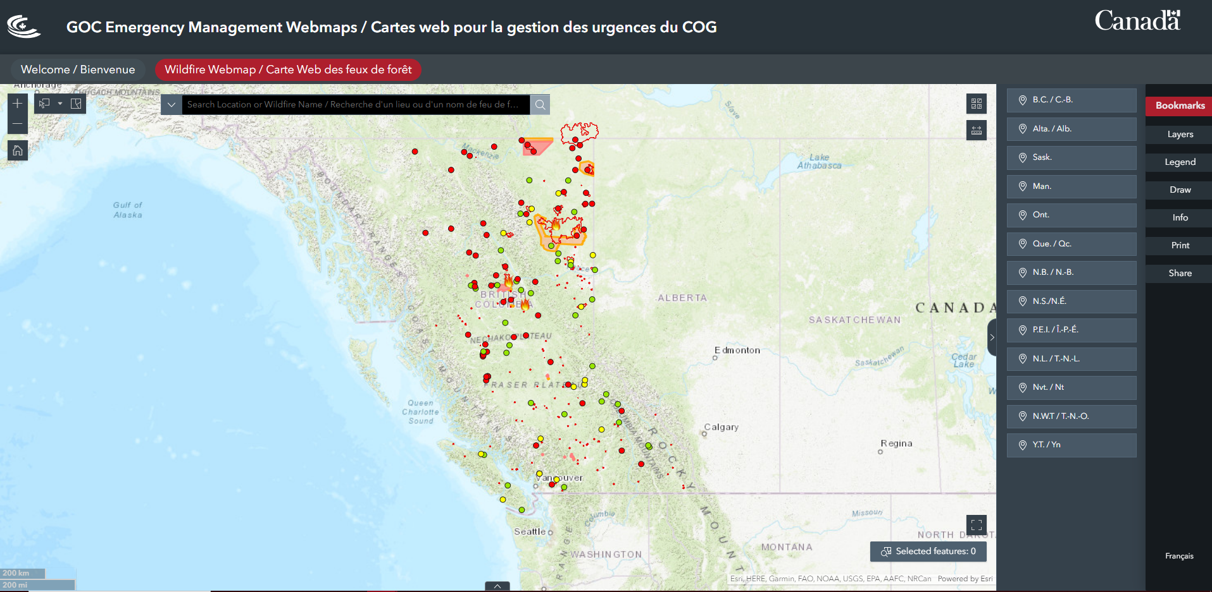
Wildfires across Canada
Wildfire Webmap
Notes:
We used experience builder to keep people informed on fires from various layers
Use Bookmarks to navigate between PTs and their various layers (grouping of layers). Each bookmark, If available, will toggle on layers relevant to that specific province or territory.
One of our feeds are fed directly from various partners, such as Canadian Wildland Fire Information System (CWFIS) and The Canadian Interagency Forest Fire Centre (CIFFC)
Our webmaps are useful not because of the Event data we have, but because of the collection of event data with other layers of demographics such as (census and FNs) and infrastructure (CI and Gov). All from authoritative sources, usually Fed but sometimes provided by the Prov govs.

Slide 14
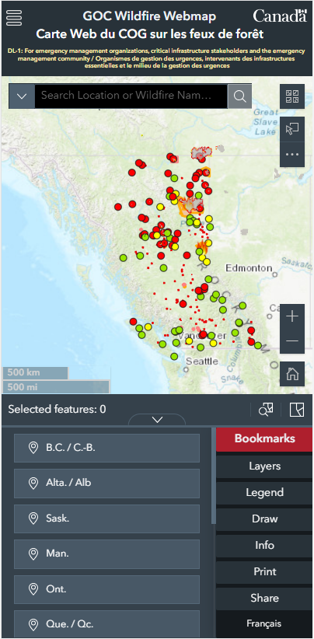
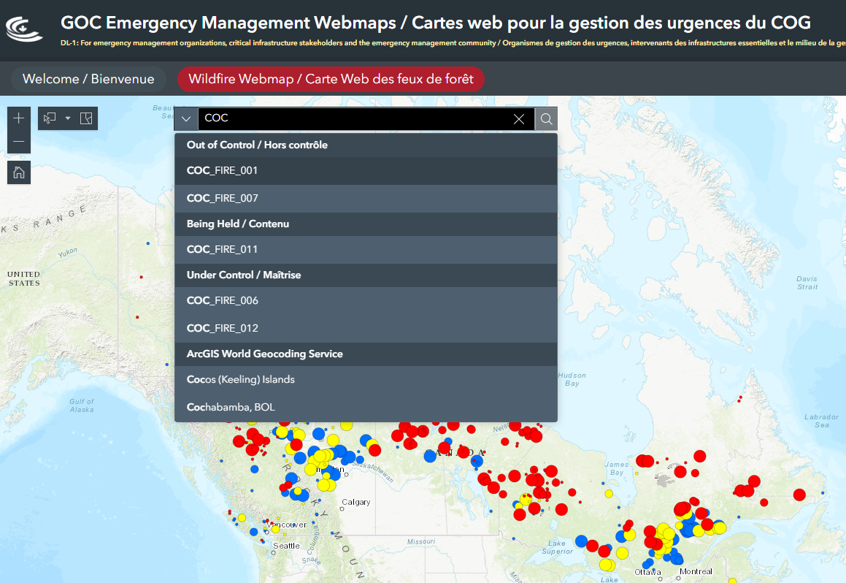
Wildfires across Canada
Wildfire Webmap
Notes:
We made it easy for EM managers to search for fires by customizing the search widget and adding in the active fires feeds
Most managers are very often working off of their mobile offices, especially while working from home or out of the office. The application works on mobile devices as well.

Slide 15
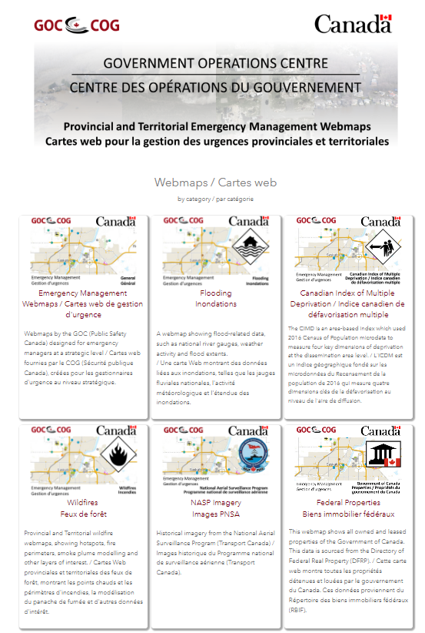
The Hub
A centralized platform
Simple to navigate
Broken down by subject
Catered to emergency managers, federal and provincial partners
Publicly accessible to be viewable by all levels of government
Listed on ESRI’s Living Atlas under the Canada – Public Safety category
Hub
https://goc-cog-pscanada.hub.arcgis.com/
Notes:
All of these three applications are available on our Hub site, which houses all of our web products intended for emergency management uses.
It is publically accessible, making it easy for all level of government to access. We are also listed on ESRIs Living Atlas under the Canada – Public Safety category

Slide 16
Contact Us
Darlene Tran
Senior Geomatics Officer
Government Operations Centre
Darlene.Tran@ps-sp.gc.ca
Geomatics Team
Ps.gocgeomatics-geomatiquecog.sp@ps-sp.gc.ca
GOC Geomatics Hub
https://goc-cog-pscanada.hub.arcgis.com/
Notes:
Feel free to contact us with any questions, here is our contact information. As well as the link to our hub site.

