Slide 1
GAC Geomatics
Introduction to the emergency management mapping team within Global Affairs Canada.
Emergency Management, Legal and Consular Affairs Branch (CFM)

Slide 2
Team makeup and history
Tools and technologies
Roles: peace time and in crisis
Products and tasks
Contact
Plan

Slide 3
The team
5 dedicated positions for geomatics specialists
Located within CET (Emergency Planning and Preparedness Division)
Begun as side of desk project in 2013
Launch of CartoVive in 2021
Emergency Management, Legal and Consular Affairs Branch (CFM)

Slide 4


Tools & Tech
ArcGIS Enterprise aka CartoVive
Maps, apps and dashboards
Expanding GIS abilities to non-GIS users
ArcGIS Field Maps aka CartoVive mobile
Mobile data collection
Tracking
Geofence alerts
ArcGIS Pro
Complex analysis and map creation
GDB and automated process management

Slide 5
Role in peace time
Supports planning and preparedness across the department
Collaborates with partners, internal, external and OGD to build synergies and capacity
Develops new products, technologies and capacities for users
Supports users to do their own cartography projects and data collection

Slide 6
Role in crisis
Once the Emergency Response Team (ERT) is activated geomatics agents move from regular hierarchy into the Incident Command System (ICS)
Located under the planning lead in the ICS
Liaises with internal and external stakeholders, metabolizes event data (including ROCA, Affected Persons, Weather Events, Crime, etc.)
Creates informative visual products for decision-making according to the needs and schedule of the crisis response

Slide 7
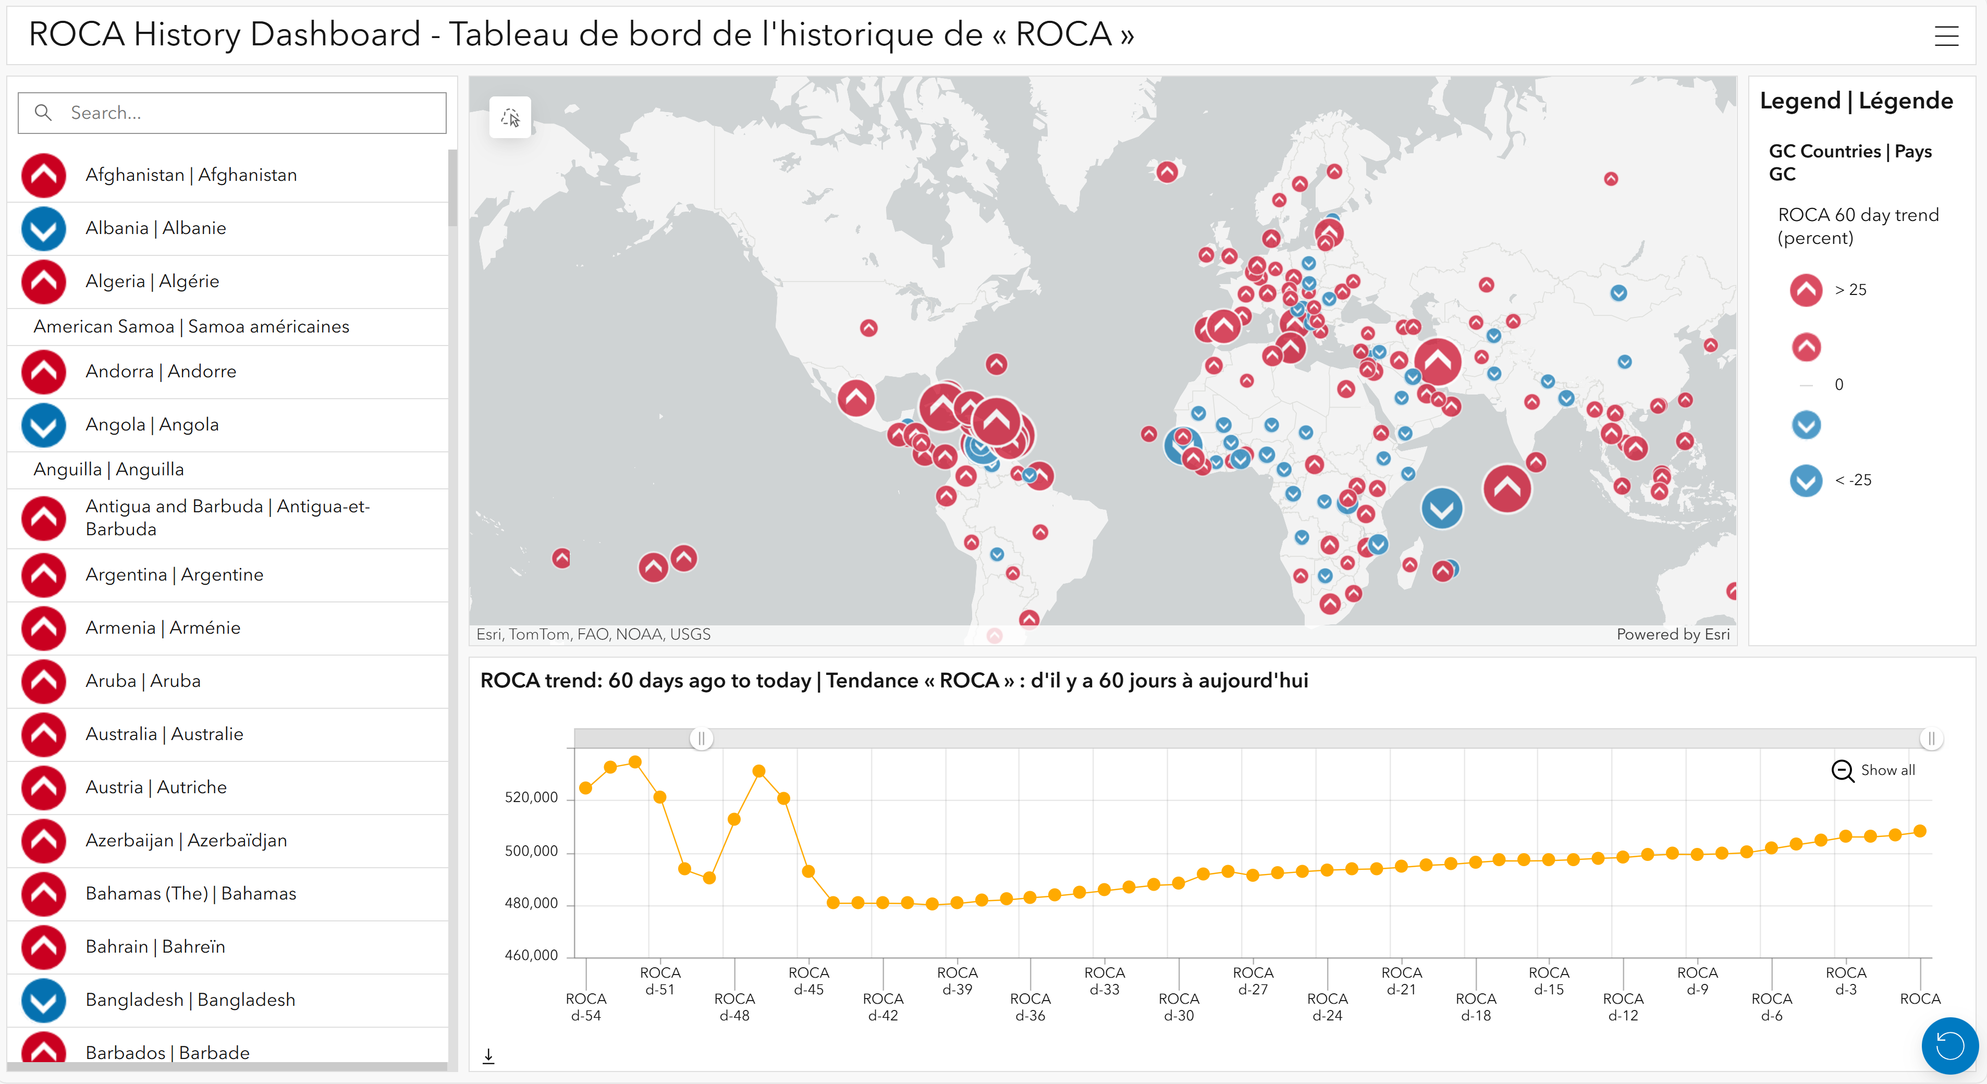
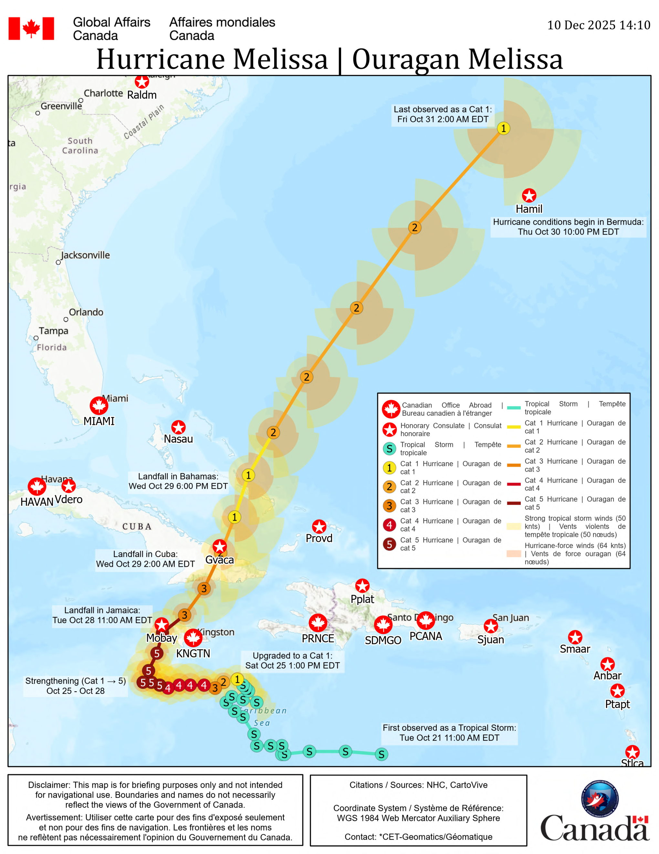
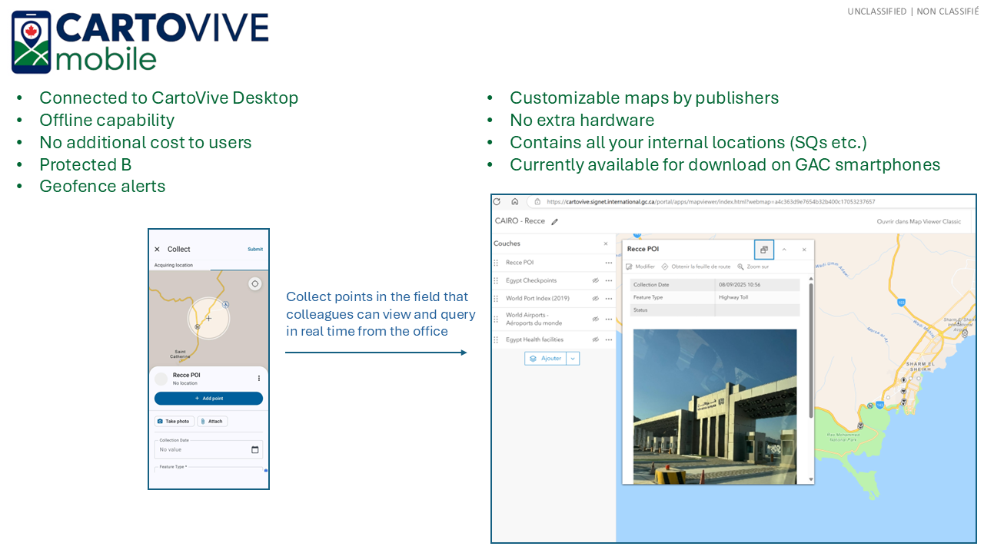
Products

Slide 8

Thank you! Contact us: cartovive@international.gc.ca

