Slide 1
UN-GGIM Paper - Authoritative Geospatial Data for Crises
Working Group on Policy and Legal Frameworks for Geospatial Information Management
United Nations Committee of Experts on Global Geospatial Information Management

Slide 2
Agenda
Introduction
Part I: Exploring Trade-offs During the Response Phase
Part II: Minimizing Trade-offs: Laws, Policies, Institutional Arrangements
Part III: Exploring User And Producer Perspectives Through Case Studies
Part IV: Guidance For Decision Makers, Providers and Users
Next Steps
Invitation for Feedback

Slide 3
Introduction
Before, during and in the aftermath of a crisis, timely access to authoritative fit-for-purpose geospatial data is critical for coordinating an effective response.
Reliable access to geospatial data throughout these crisis phases is enabled by targeted legislation, regulation and policies situated within a robust national policy and legal framework.
When responding to a crisis response, trade-offs may arise as priorities are realigned to reflect the urgent need for timely and available data, particularly in jurisdictions lacking enabling laws and policies.
Characteristics that make data fit for purpose can shift as a crisis evolves from one phase to the next.

Slide 4
Introduction (2)
This discussion builds on a previous paper endorsed at the thirteenth session of the Committee of Experts, titled “Authoritative Data in an Evolving Geospatial Landscape: An Exploration of Policy and Legal Challenges”.
The current paper explores the pre-conditions for trust of authoritative, fit for purpose data used during crises, which involves the development of robust policy and legal frameworks and institutional arrangements in the pre-crisis phase.
In order to establish trust, government authorities are encouraged to implement legal and policy tools and institutional arrangements to enable transparent access to fit for purpose data needed for effective crisis response.
The “control vs. trust continuum”.

Slide 5
Part I: Exploring Trade-offs During the Response Phase
Crisis scenarios often give rise to a need to reprioritize traits (“characteristics” ) used to designate data as authoritative.
During a crisis, authoritative data must above all be easily accessible and reliable, capable of supporting real-time decision-making, and adaptable to various scales and scenarios.
Having access to data with these characteristics ensures data users (including responders) can effectively analyze the situation, plan interventions, and manage resources in a timely and informed manner.
When data accessibility and timeliness become the preeminent considerations, users may need to adjust criteria used to identify data as fit for purpose.
Prioritizing accessibility and timeliness may involve compromises in other data characteristics or principles, such as quality or privacy and security.

Slide 6
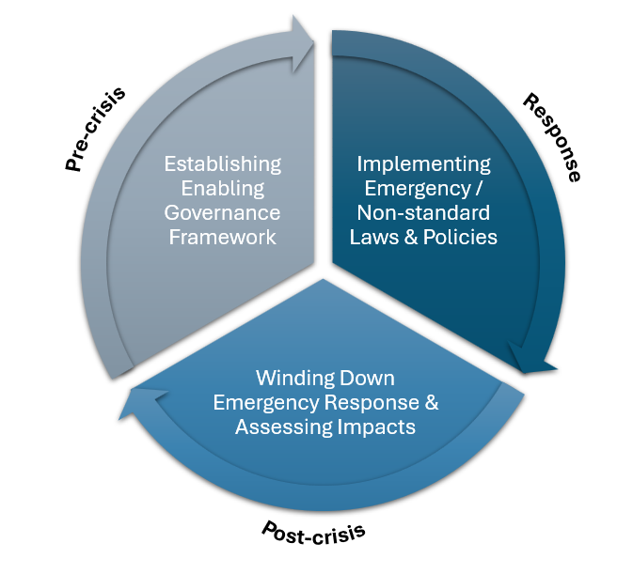
Part II: Minimizing Trade-offs: Laws, Policies, Institutional Arrangements (1)
Pre-crisis, law and policymakers have the opportunity to establish robust governance frameworks, including enabling policy and legal tools and institutional arrangements, in preparation for worst-case scenarios.
Establishing robust governance frameworks before they are needed can help to minimize trade-offs in data characteristics when a crisis arises.
A “robust” governance framework includes provisions for intellectual property, data privacy and security, liability, legal interoperability, licensing, data quality and equity.
In the response phase, these pre-established enabling legal and policy tools and institutional arrangements are “put to work”, facilitating access to fit-for-purpose data in real time.
During this phase, it may be necessary to implement temporary emergency or non-standard laws and policies to expedite data sharing by providing targeted/limited access.

Slide 7
Part II: Minimizing Trade-offs: Laws, Policies, Institutional Arrangements (2)
Post-crisis, extraordinary legal and policy measures introduced to provide limited targeted access to data should be reversed, with steps taken to restore the rule of law to baseline “pre-crisis” status where necessary.
Policy makers can also conduct impact assessments of the response efforts. This can include an appraisal of impacts to humans, resources and infrastructure, with demographic data providing insight into response outcomes for the broader population as well as for marginalized groups.
There is also an opportunity to observe which types of laws and policies produced an enabling versus hindering effect on facilitating timely data access and initiate any necessary adjustments.

Slide 8
Part III: Exploring User And Producer Perspectives Through Case Studies
Part III includes 4 case studies of policy and legal instruments or institutional arrangements that facilitate timely data access in a crisis, highlighting the distinctive data producer and user roles.
International Charter: Space and Major Disasters
Association of Southeast Asian Nations (ASEAN) Leaders' Declaration on Disaster Health Management
Humanitarian Data Exchange (HDX)
Flood Mapping in Canada

Slide 9
Part IV: Guidance For Decision Makers, Providers and Users (1)
Pre-crisis
Data Sources & Providers | Have potential sources and providers of authoritative data during a crisis been identified? Which of categories do providers fall into? (e.g., Government departments or agencies, bilateral/multilateral organizations, private sector, etc.)
Data Characteristics | Have data characteristics that make the data fit for the purpose of responding to a crisis been identified?
Legal & Policy Considerations | How do existing laws define / affect the following data characteristics? Data privacy & security Intellectual property Licensing & legal interoperability Liability Demographic data
Institutional Arrangements | Which of the following have been or could be established to facilitate timely sharing of fit-for-purpose data during a crisis? Collaborative partnerships (inter-agency organization International standards collaboration Validation Frameworks for VGI sources

Slide 10
Part IV: Guidance For Decision Makers, Providers and Users (2)
Response
Considerations for Users | Are available fit for purpose data sources being successfully harnessed? If critical data gaps emerge in real-time, are steps being taken to minimize trade-offs in data characteristics when seeking alternate data sources? Do users have a framework for identifying alternative fit for purpose datasets when gaps in needed data emerge? Are responders aware of any deficiencies in the quality of datasets they are using? Do they understand the margins of error and associated risks?
Considerations for Providers | Are data providers available to offer technical support and guidance to responders as needed? Where applicable, are providers adhering to agreed upon terms for providing data that is timely, up-to-date, and adheres to established quality standards? For government providers only: Have the legal criteria to activate emergency response measures granting special access to sensitive or protected data been met?

Slide 11
Part IV: Guidance For Decision Makers, Providers and Users (3)
Post-crisis
Winding Down Emergency Measures | Have emergency law and policy measures introduced or activated during the crisis been appropriately wound down? Have rights, privileges or protections that were suspended to facilitate data access during crisis response been restored? E.g., If security and privacy protections were temporarily suspended to enable limited and targeted access to critical data under emergency conditions, have these measures since been restored?
Reviewing Lessons Learned | Did data providers and users adhere to applicable laws, regulations and policies in their handling of critical authoritative data harnessed for crisis response? Did government providers and users fulfill their established roles and obligations during the response phase? Did responders face barriers to accessing critical data during the response phase? How can gaps in data access be mitigated in future crises? Did responders make any trade-offs in data characteristics during the response phase due to data availability/timeliness? If so, what was the nature of these trade-offs, and how can they be avoided or mitigated in future crises?

Slide 12
Next Steps
Final paper to be tabled at the Fifteenth Session of UN-GGIM, 6 – 8 August 2025.

Slide 13
Thank you

Slide 14
Invitation for Feedback
The United Nations Committee of Experts on Global Geospatial Information Management (UN-GGIM) Secretariat together with the UN-GGIM Working Group on Policy and Legal Frameworks for Geospatial Information Management has invited the Committee of Experts and relevant stakeholders to review and comment on the draft Paper, “Authoritative Geospatial Data for Crises”.
While much of the content and guidance relates to Member State driven instruments, the perspectives of a range of stakeholders (including private sector, civil society and academia) on how to best address the needs of data users and providers in crisis scenarios are welcomed also.

Slide 15
Invitation for Feedback (2)
Participants are asked to consider:
The paper’s representation of trade-offs in data characteristics that responders face during a crisis.
The inclusion of relevant legal and policy considerations and tools for geospatial data producers and users across all crisis phrases.

Slide 16
Invitation for Feedback (3)
Additionally, please consider:
The applicability of guidance included in the “Checklist for Data Providers and Users” (Part 4) to a variety of national contexts and crisis scenarios.
The paper’s overarching consideration of both the data user and data provider perspectives, as well the perspectives of both state and non-state entities involved in crisis response, in addition to pre-and post-crisis activities.

Slide 17
How to Submit Feedback
Please review the draft and submit your comments and feedback using the template provided to nrcan.un-ggimsecretariat-secretariatun-ggim.rncan@canada.ca no later than 7 May 2025.

Slide 18
We welcome your questions and feedback

