Slide 1
Canada Structures Dataset Overview
Data Science and Engineering Team
Resilience and Economic Integration Division
Public Safety Canada
May 15 2025

Slide 2
Public Safety Canada
Public Safety Canada (PS) is a federal department with a mandate to keep Canadians safe from a range of risks, including crime, terrorism, and ‘natural disasters’.
With the support of the Chief Science Advisor, we have been directed by the Prime Minister to further incorporate science into all elements of emergency preparedness.
In 2020, the Data Science and Engineering Team (DSET) at PS was founded to build the department’s scientific and engineering capabilities.

Slide 3
Introduction
Canada Structures
The Canada Structures dataset is a comprehensive geographic dataset of building footprints for Canada.
The product is (SOON TO BE) available at no cost on the Open Government of Canada website: http://open.canada.ca .
Citation: Sandison J., Hayes S., Darlington C., Chastko K and Ballard M. 2025. Canada
Structures data product. Public Safety Canada, Resilience and Economic Integration
Division, Data Science and Engineering Team, Ottawa, Canada

Slide 4
Introduction
Public Safety Canada has an ongoing requirement to establish and maintain a geospatial building data layer to be used for multi-hazard risk research.
Canada Structures has 13,760,754 building polygons across Canada, developed from three open data sources:
Open Data Base of Buildings (ODB)
Open Street Maps buildings (OSM)
Microsoft Building Footprints (MSB)
Through data processing methods, DSET compared features in theses layers, and developed methods to combine these layers to make an enhanced collection of higher-quality building footprints.

Slide 5
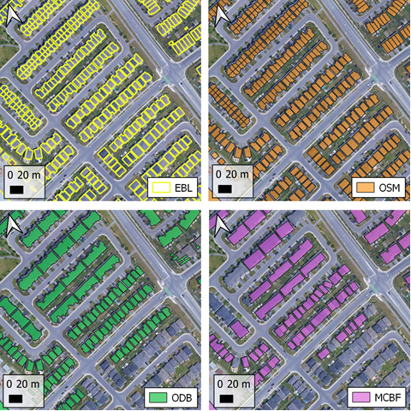

Slide 6
Introduction
Each of the ODB, OSM and MCBF data sets have value on their own, however the combination of these presents additional value based on coverage, accuracy, and precision.
The MCBF developed using machine learning from satellite imagery. MCBF included buildings in communities which lacked coverage from the other data sources. However, the precision of building ‘rooftop’ geometry is less accurate, on average.
The OSM and ODB rely on human-entered digitizing of building data, generally by GIS analysts, and are generally more precise.
The combination of each data source represents the leveraging of both human-drawn and machine-detected imagery for a paired coverage significantly greater than each individual data set on its own.

Slide 7
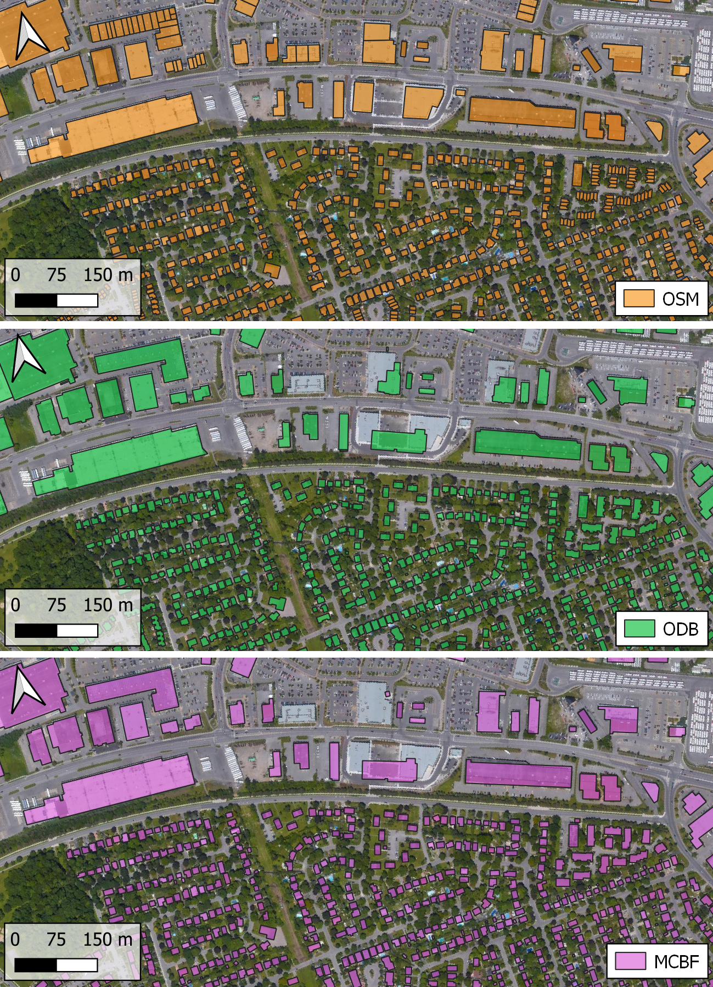
Combining Sources
Riverview Park Neighbourhood of Ottawa, Ontario we can see that all data sources generally capture the stock of buildings in the map coverage area.
However, OSM has additional coverage and parses more units of side-by-side buildings than both ODB and MCBF.

Slide 8
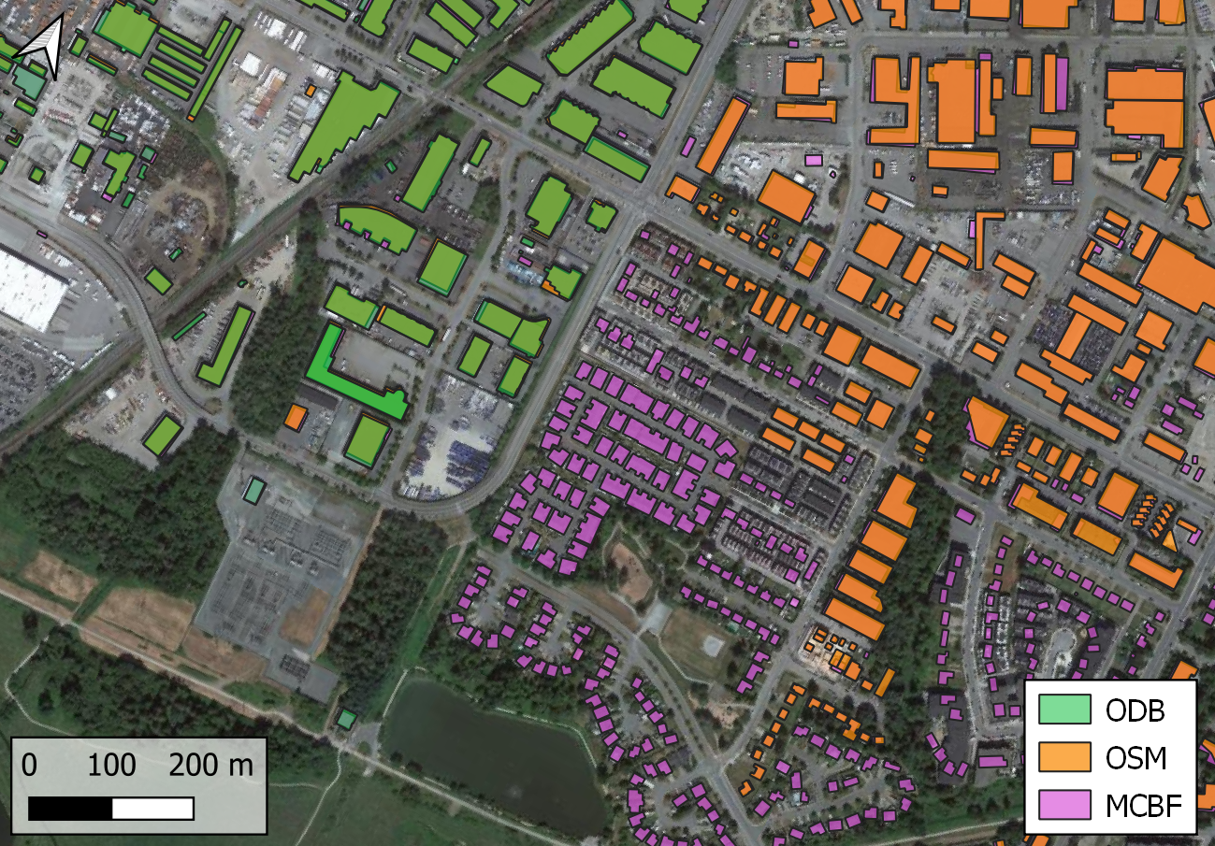
Combining Sources
In the Langley, British Columbia, ‘stacking’ the layers using ODB, then OSM, then MCBF, shows MCBF is uniquely available and covering the south-eastern extent of the map area.
OSM provides coverage in the north-eastern extent of the map, and ODB is only available in the north-western region.

Slide 9
Combining Sources
MCBF data was published in 2019, has wide coverage.
The ODB building footprints were collected by Statistics Canada from municipalities between January to August 2018 for version 1.0 and February 2019 for version 2.0 (Statistics Canada, 2020a).
OSM is updated frequently and the latest version of this data was downloaded on January 1, 2023.
Where there are overlaps of building polygons across datasets will result in only one of the provided building polygons being preserved.

Slide 10
The Initial Canada Structures Set
14 million footprints across Canada
An aggregation of three big datasets:
Microsoft Building Footprints
6.5 million footprints
Open Street Map (OSM)
6.2 million footprints
Open Database of Buildings (ODB)
1.3 million footprints

Slide 11
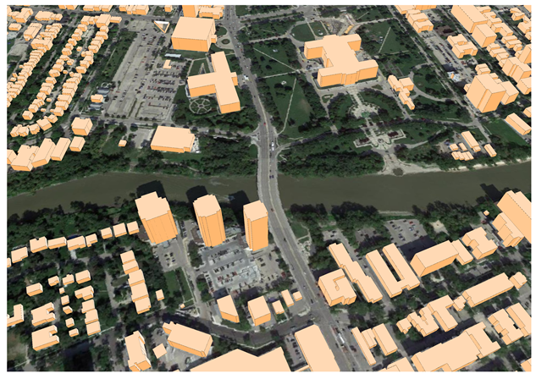
Adding Building Height
Challenge: identifying the apartment and condominium buildings
Solution was to add a height dimension to the data, which quickly differentiates high-rise and low-rise buildings from the typical single-family or other occupancy types.
DSET leveraged the open-sourced High Resolution Digital Elevation Model (HRDEM) data available from Natural Resources Canada, which includes high-resolution lidar data across sections of Canada.

Slide 12
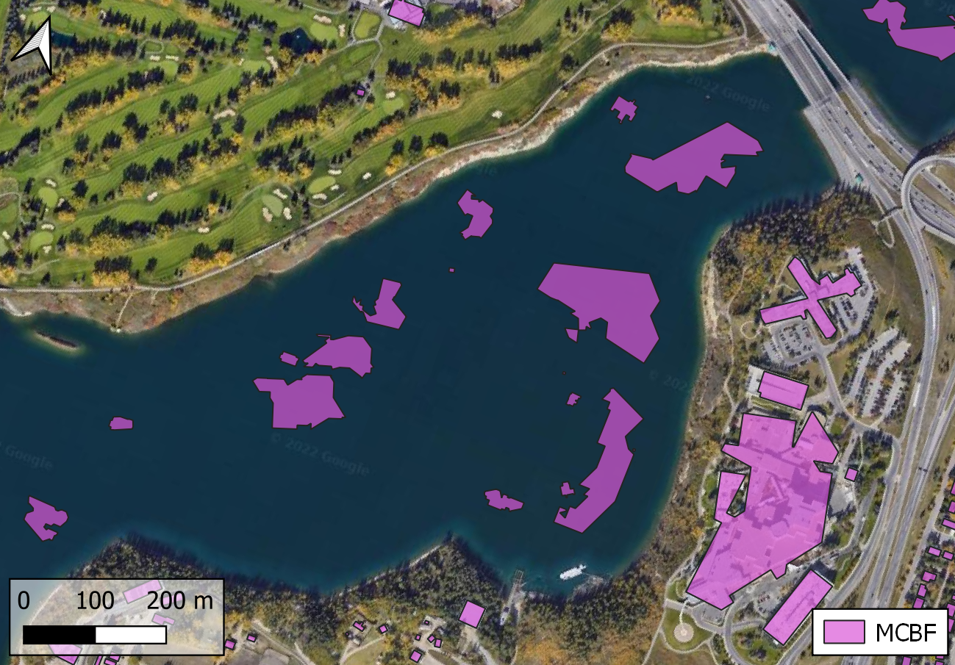
Quality Control Analysis
Problem
The initial building footprint dataset featured thousands of obvious errors, mostly from Microsoft Building Footprints (MCBF).

Slide 13
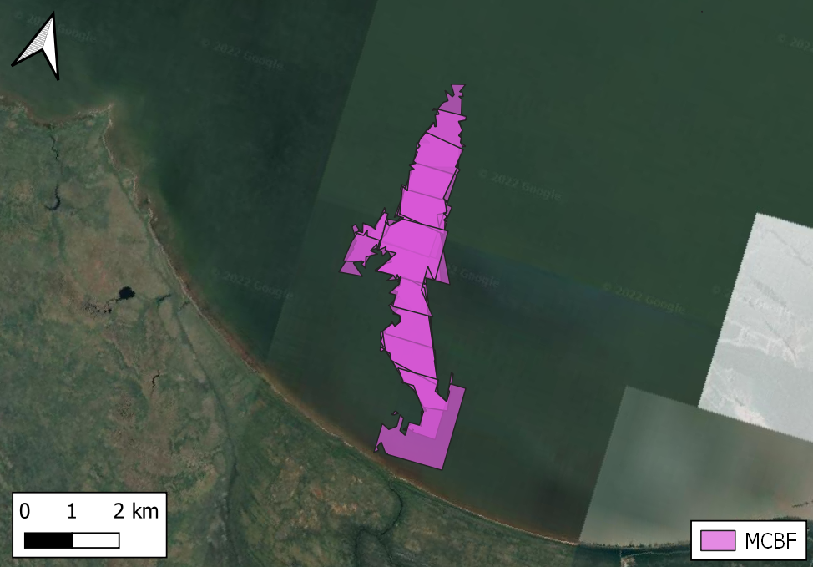
What are Errors?
Errors!
The model draws a polygon for something it thinks is a building.
In reality, this could be almost anything that is not a building.

Slide 14
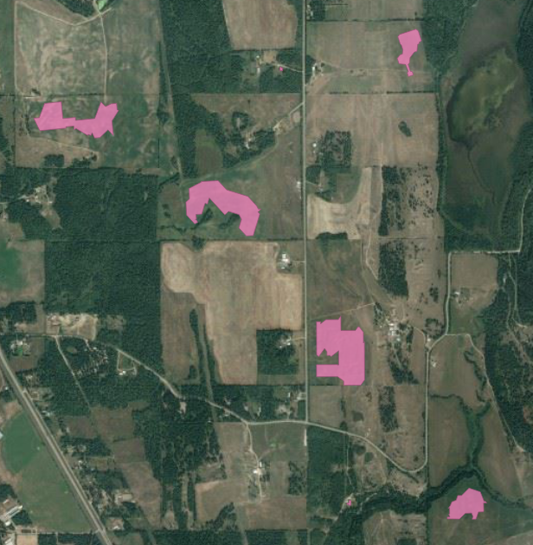
What are Errors?
Errors!
The model draws a polygon for something it thinks is a building.
In reality, this could be almost anything that is not a building.
Crop fields

Slide 15
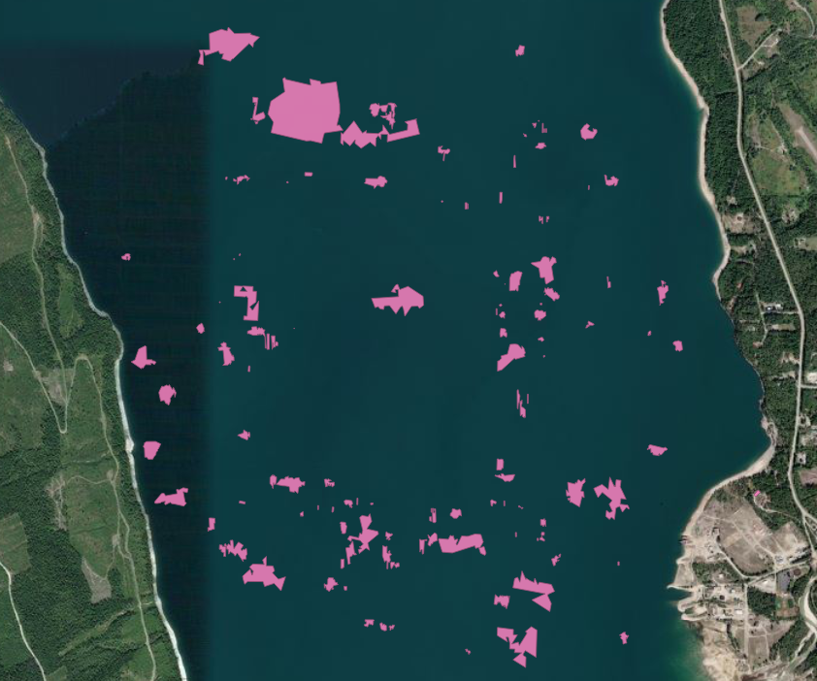
What are Errors?
Errors!
The model draws a polygon for something it thinks is a building.
In reality, this could be almost anything that is not a building.
Water

Slide 16
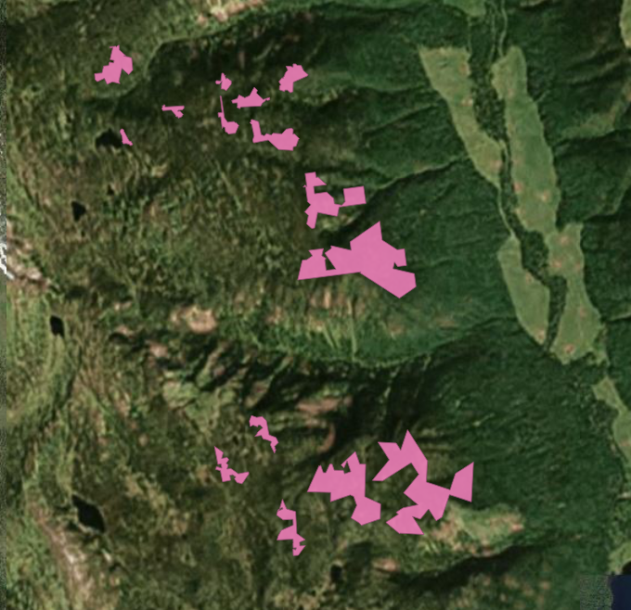
What are Errors?
Errors!
The model draws a polygon for something it thinks is a building.
In reality, this could be almost anything that is not a building.
Mountains

Slide 17
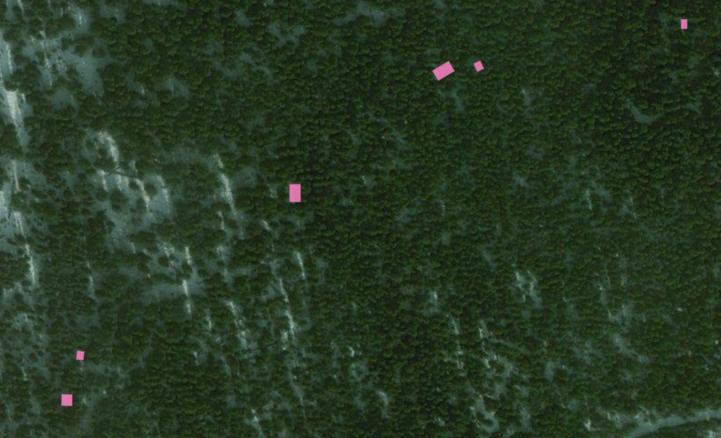
What are Errors?
Errors!
The model draws a polygon for something it thinks is a building.
In reality, this could be almost anything that is not a building.
Space in Forests

Slide 18
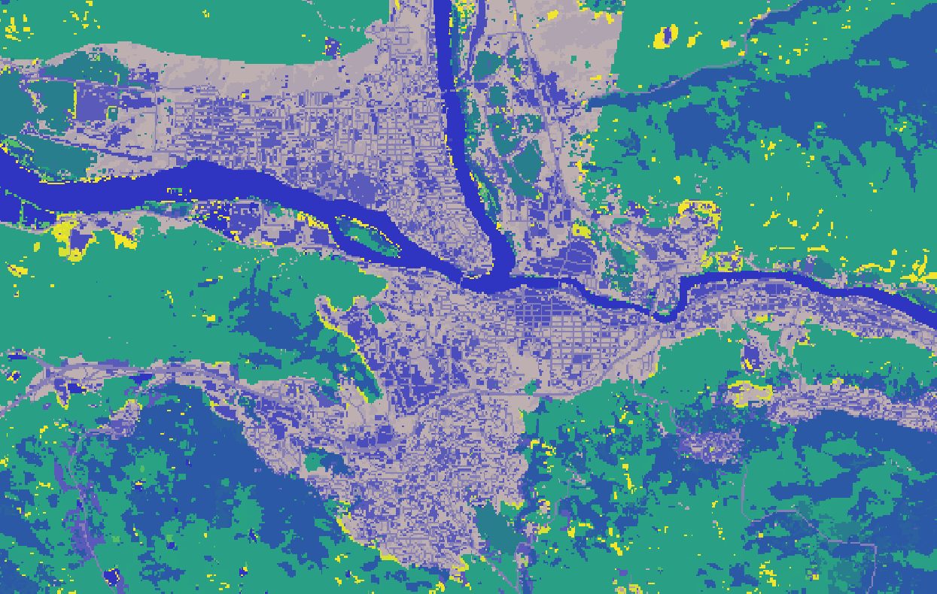
Step 1: Attaching Key Features
Agriculture and Agri-food Canada – Semi-Decadal Land Use Time Series
Consolidated Raster across Canada
30m x 30m grid of land use
Label for each band value
Settlement
Crop
Forest
Water
Rock
Snow
Zonal Statistics (QGIS) to derive majority, min and max of a footprint
Kamloops, British Columbia
Notes:
Improvements to this layer could be the ESRI Land Cover Layer, 10m x 10m resolution… AAFC product may be derived from that

Slide 19
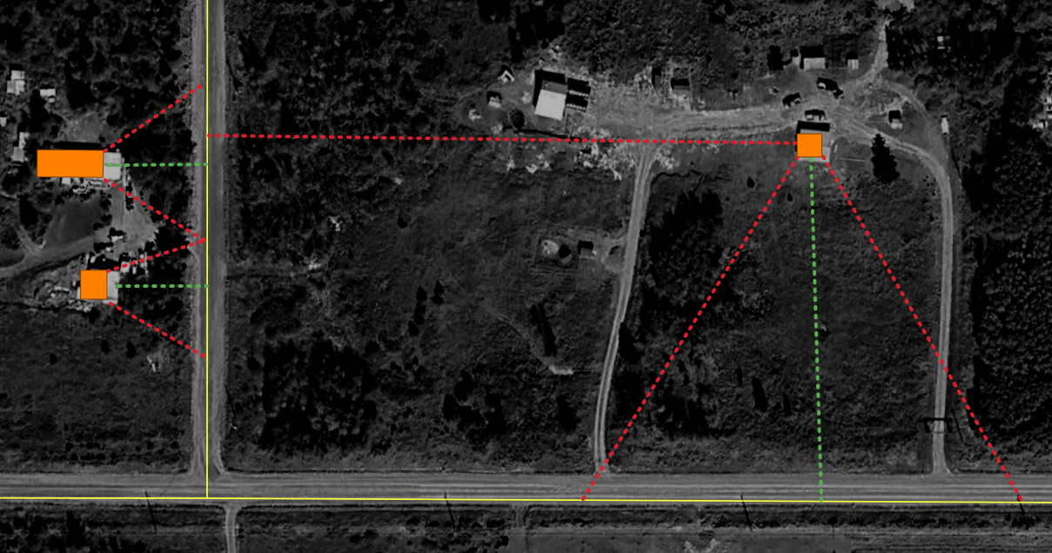
Step 1: Attaching Key Features
Nearest distance to a road
A proxy for ‘civilization’
Most errors are rural or remote
Most buildings are near roads
Open Street Map
Hand-drawn road geometries across Canada
Generate spatial index
Find nearest candidates
Select candidate with lowest distance, assign to building
Loop for all 14 million geometries

Slide 20
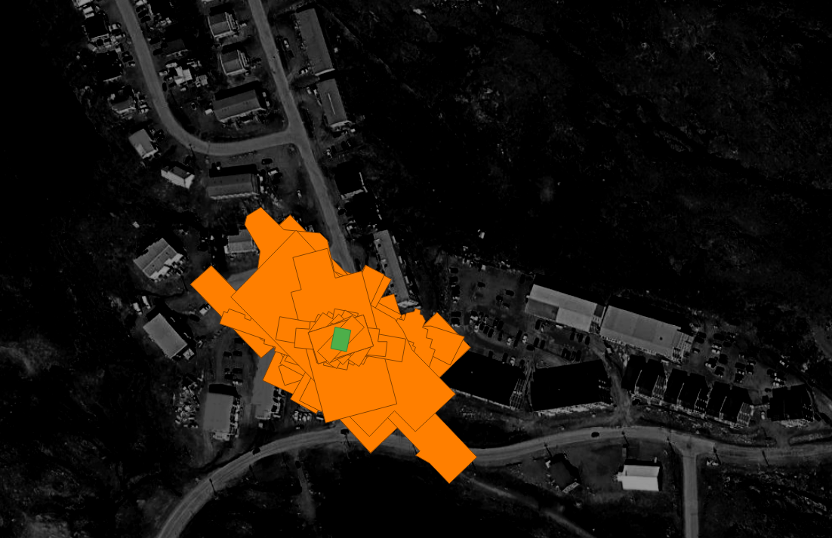
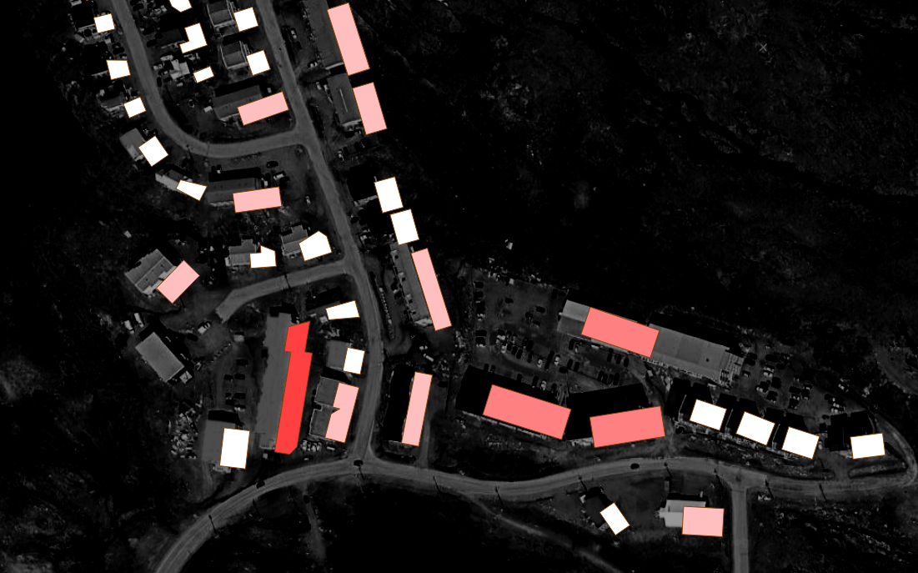
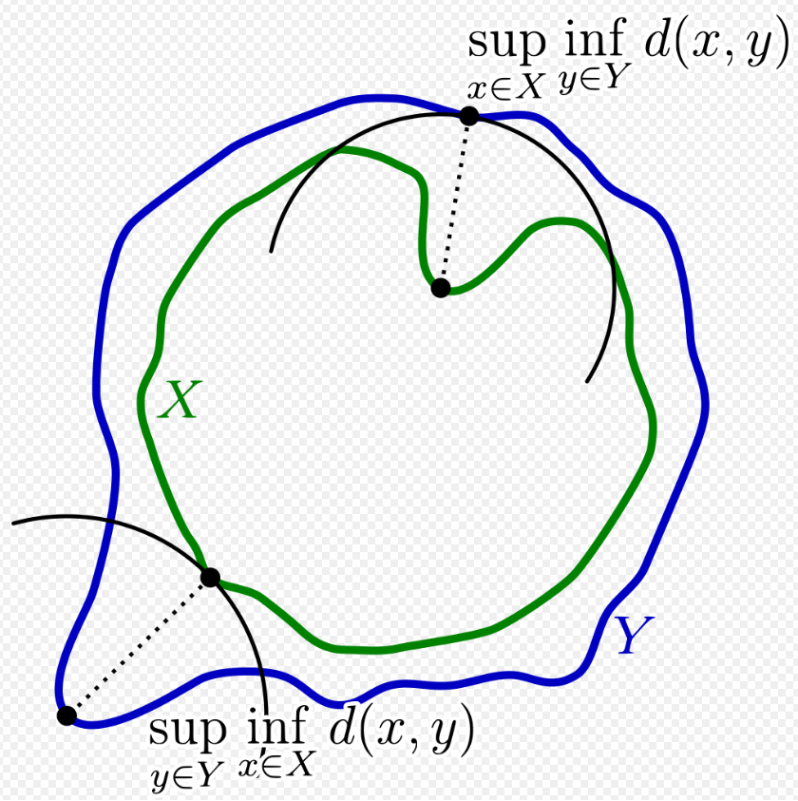
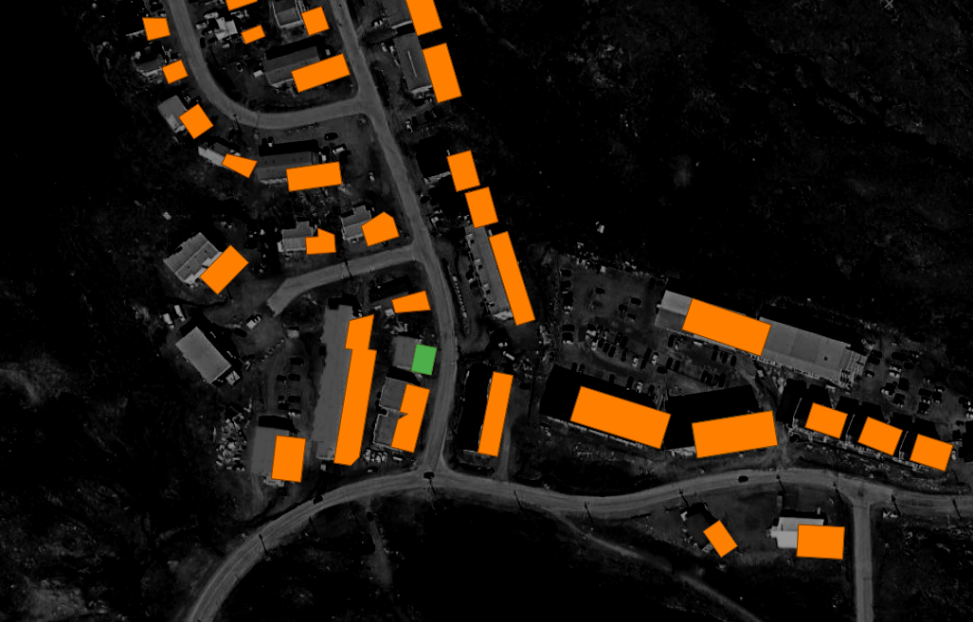
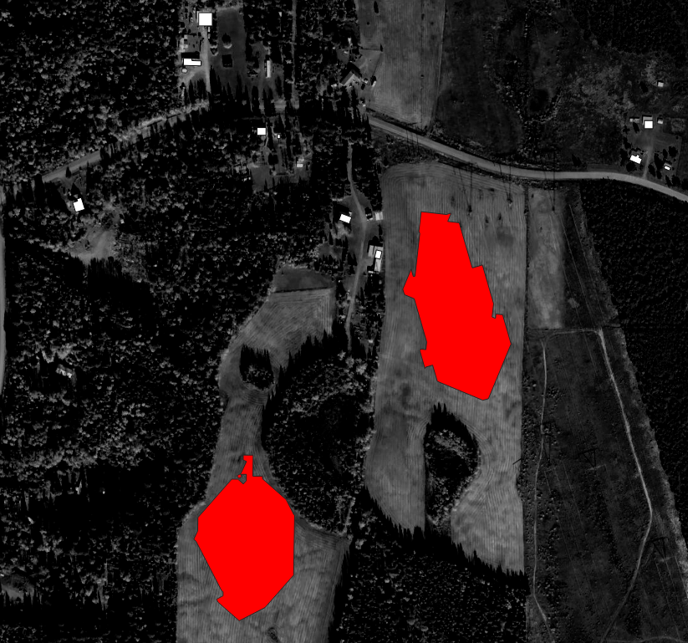
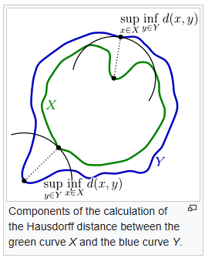
Step 1: Attaching Key Features
Shape Analysis (like MCBF)
Hausdorff Distance: the longest travel distance between two shapes
Assumes geometries are ‘centrally stacked’
Programmatical challenge
Find an ideal residential ‘archetype’
Move geometries to a ‘stack’
Iterate Hausdorff calculation
Attach distance value to building
Loop for all 14 million geometries
Wikipedia 2023
Notes:
Hausdorff – “What’s the longest distance I could make my opponent (in Green) walk?”

Slide 21
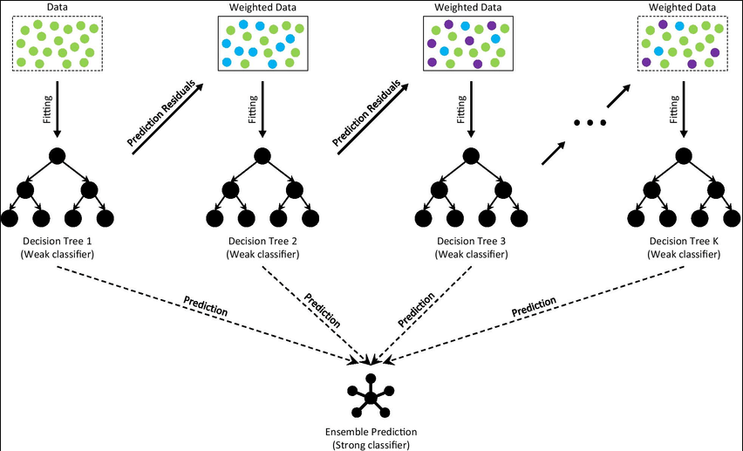
Step 2: Classify Errors
Machine Learning Model
Either a ‘Pass’ or ‘Fail’
Gradient Boosting – a probabilistic output from a decision tree ensemble
Trained on all key features
From a tree, makes a guess
Compares to training data
Assigns ‘weight’ to relevant data
New tree, new guess
Compares guess to last tree
Etc…
Deng et al. 2021
Notes:
It starts by fitting an initial model (e.g. a tree or linear regression) to the data. Then a second model is built that focuses on accurately predicting the cases where the first model performs poorly. The combination of these two models is expected to be better than either model alone. Then you repeat this process of boosting many times. Each successive model attempts to correct for the shortcomings of the combined boosted ensemble of all previous models.

Slide 22
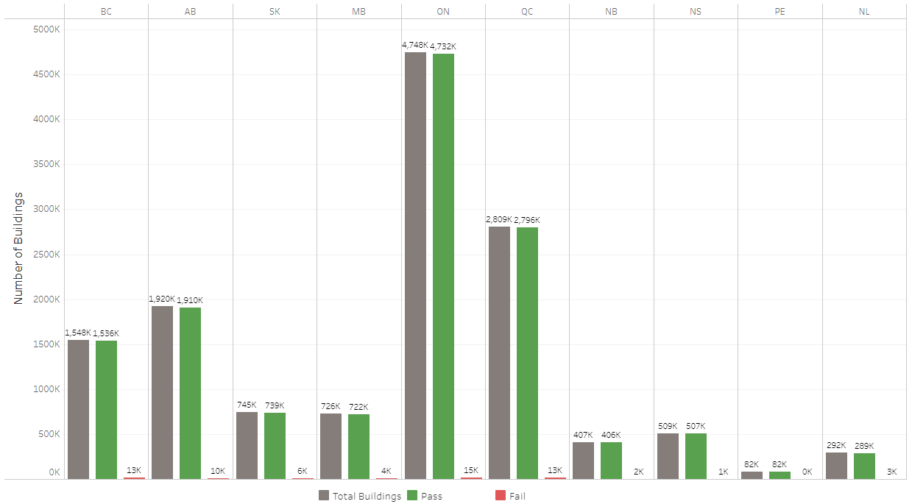
Results
68623 Errors identified
Avg ~1% of whole dataset
Most errors in Ontario and Quebec
BC has higher errors even with less buildings than Alberta
Error distribution not related to relative amount of buildings
Visual Inspection shows
High accuracy in detection
Bias: water-access buildings, long driveways, industrial sites

Slide 23
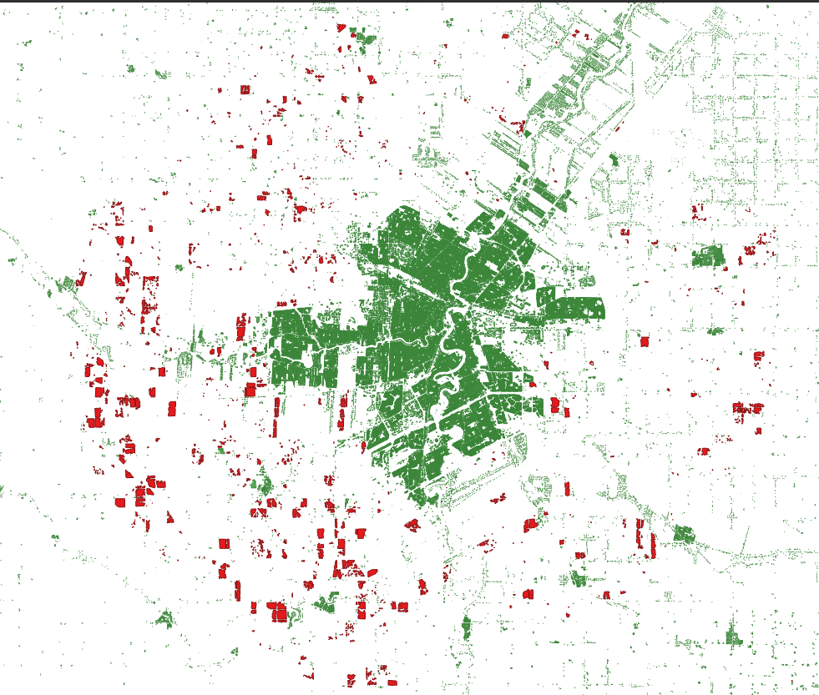
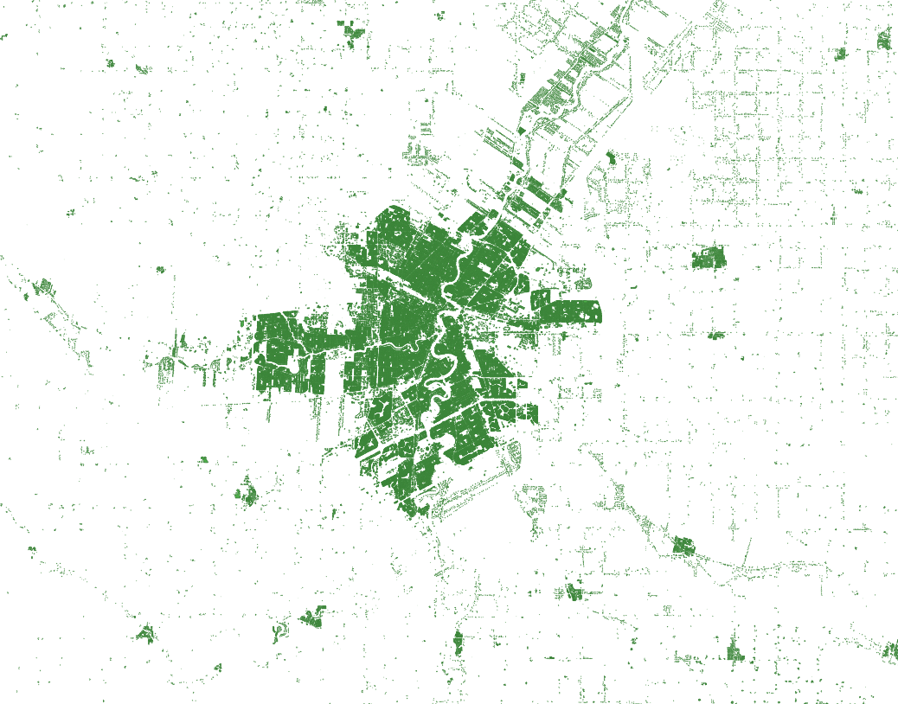
Results
Before
Winnipeg, MB
After

Slide 24
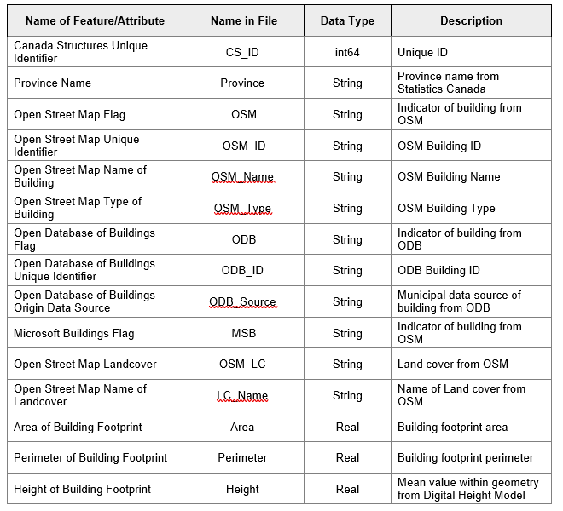
Results

Slide 25
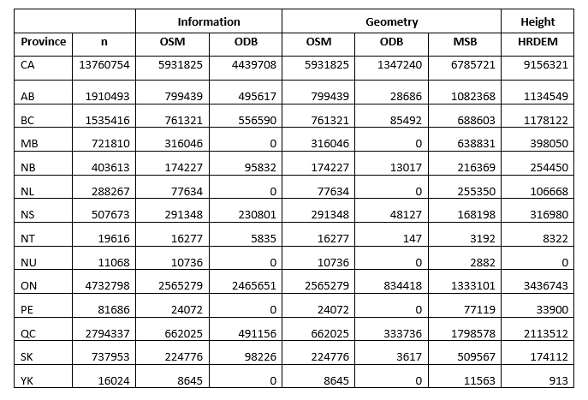
Results
Before
Winnipeg, MB

Slide 26
Have a look: GOC Emergency Management Web Maps
https://goc-cog-pscanada.hub.arcgis.com/
https://experience.arcgis.com/experience/51205886ce3143db92629244ddd3274a/page/Infrastructure?views=Layers
Thank you, Questions?

