Slide 1
UNCLASSIFIED
National Evacuation Reporting Dataset
NERD
By GOC Geomatics
April 8, 2025
Notes:
Explanation today
Trial tomorrow
Tuesdays - Coincides with duty tm changeover
Explains who fills in what part.
You need to bring a notepad

Slide 2
Evacuation Reporting requests
Numerous requests for evacuation data have come to the OpsCen and GOC-Geo from:
Elections Canada
Service Canada
Canada Post
StatsCan
PS – Canadian Disaster Database
There is a general assumption that the GOC holds this data and it’s available for access later
This assumption comes from the fact that the GOC receives this information direct from P/T partners or from the RO’s, and reports on it daily
This type of information is not currently catalogued by the GOC

Slide 3

NERD – National Evacuation Reporting Dataset
The Goal
Create a system that will collect evacuation data from the P/T’s and ISC.
The information will then be standardized and merged into a singular dataset, automatically translated by DeepL, then made available to everyone.
The dataset can be used by the GOC and partners for:
Cyclical reporting
Mapping
AARs
Plans
Accessible as a dynamic mapping layer
Can be connected to PowerBI for dynamic charts (with the applicable connector)
Downloadable as a stand-alone table
Monthly archive of the data to facilitate after-action analysis

Slide 4
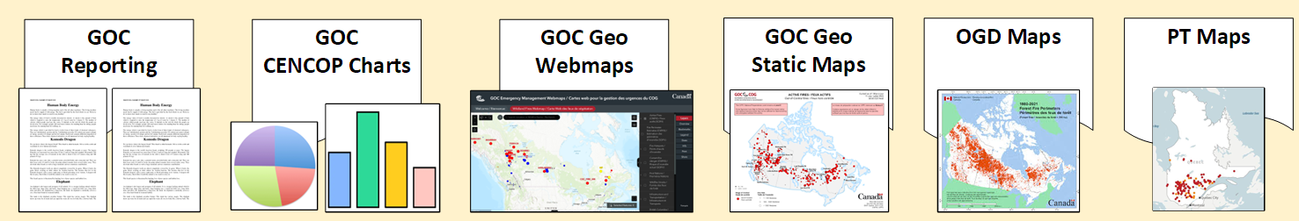
Project Plan
1
4
Scrape evacuation data from Provincial sources online
6
Create Point and Polygon data from the merged set
Share with Partners
3
Standardize the info and merge into 1 dataset
- Auto Translate
2
5
Receive information from partners as reports and enter it into a form that will ‘digitize’ it.
Daily and Monthly archive

Slide 5
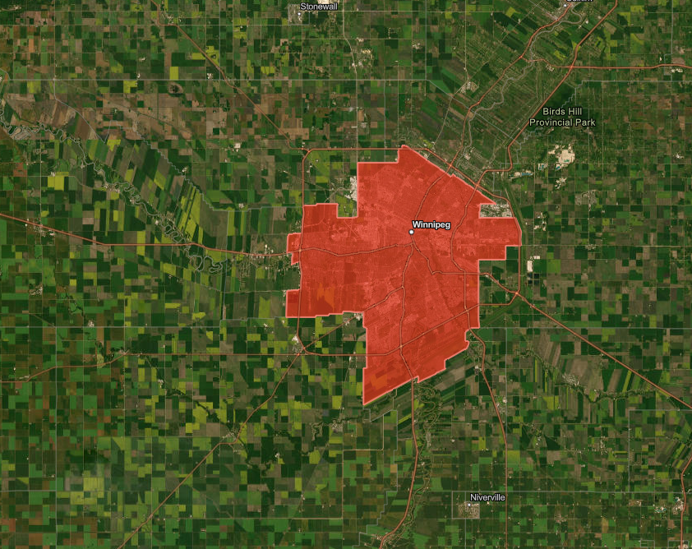
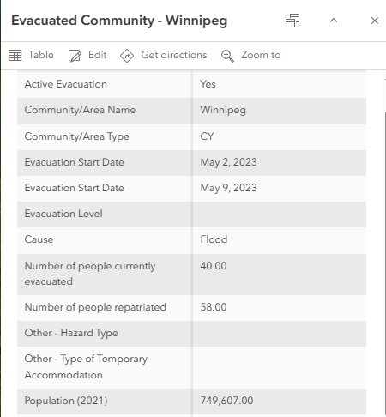
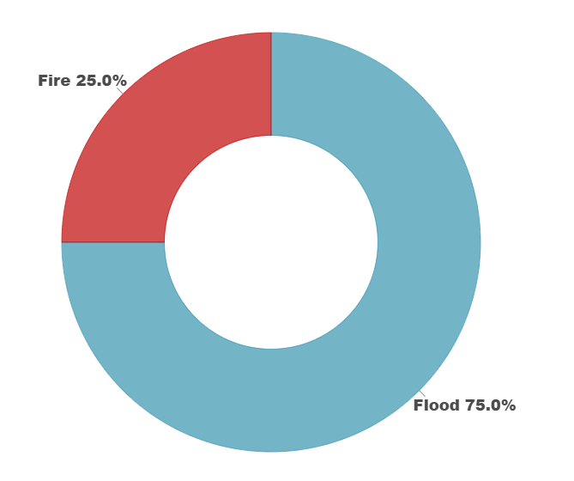
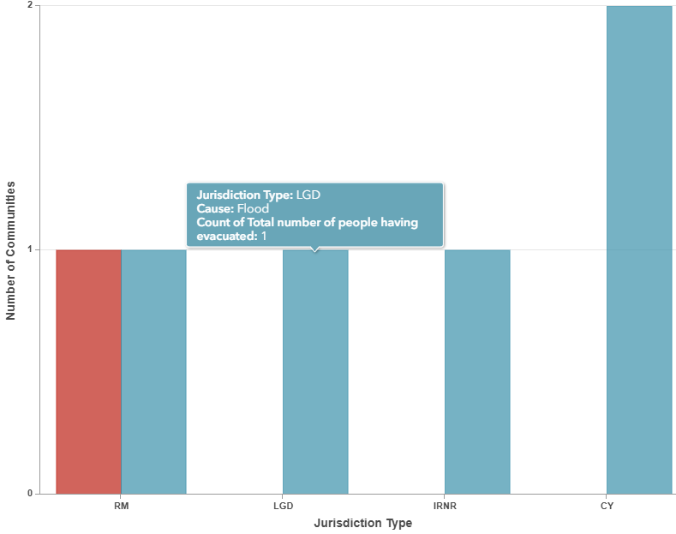
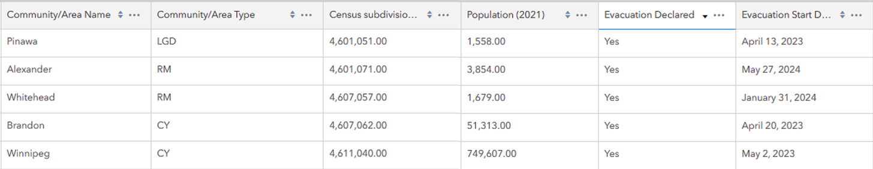
Outputs
Versatile. Automated. Collaborative. Real-time.
Map Layers
71 Columns in the Database.
Only a portion are used for a typical evacuation.
Most are conditional based on Event type.
For example, for an evacuation caused by Wildfire:
14 Data fields would be filled by a person
14 Data fields would be auto-filled
28 Data fields total for this evacuation
Dashboards
Datasets

Slide 6
Timeline
2023
2023
GOC Geo determined the need for this dataset, as no other groups were doing it.
Developed a preliminary project plan
2024
Visited several PS ROs and EMOs and discussed the project, determining interest and sources of data. Consulted NRCan-CFS on their preliminary work in this field.
Advanced the project plan to include assignments and staffing requirements
Discussed the project and its data with Planning, Ops, ECIS
Hired a student programmer to help with the coding aspects
2025
Began development of the scripts that will ‘scrape’ the data from online sources.
Data collection fields finalized and consulted with GOC Divisions
Expected completion – summer 2025
2024
2025

