Slide 1



GOC
OSINT TEAM
OPEN-SOURCE INTELLIGENCE TEAM
PUBLIC SAFETY CANADA
GOVERNMENT OPERATIONS CENTRE
Provide an overview of the OSINT Team’s strategic purpose, core functions, and operating model. Demonstrating how it delivers value through situational awareness, timely insights, and supports informed decision-making in a complex information environment.

Slide 2

Open-Source Intelligence (OSINT)
“OSINT is intelligence derived from the collection and analysis of publicly available information and data, in alignment with government mandates and authorities, to address defined intelligence requirements.”
Intelligence Analyst Community of Practice (IACOP Definitions, 2025)
Publicly Available Information
“Information that has been published or broadcast for public consumption, is accessible on the global information infrastructure or otherwise, or is available to the public upon request, by subscription, or purchase. It does not include information in respect of which a Canadian or a person in Canada has a reasonable expectation of privacy.”
Communications Security Establishment Act (S.C. 2019, c. 13, s. 76)

Slide 3

GOC OSINT
ABOUT
US
2023 Approach
Sept 2024 – Present
• No dedicated OSINT team.
• Open-source monitoring done by Watch Officers alongside other duties.
• First Alert used occasionally, not fully leveraged.
• OSINT recognized as time-intensive and requiring specialist focus.
• Dedicated OSINT team created; expanded to 8 staff.
• First Alert embedded as primary early-warning tool.
• Capability gaps identified, need for depth collection and tailored outputs.
• Second tool developed to complement First Alert and extend coverage.
2022
2023
Sep 2023
Sept 2024
2025
OSINT Team Established
Custom Tool Created
Freedom Convoy Demonstration
Initial Use of First Alert
Integration with ArcGIS
Highlighted the need for a dedicated OSINT capability at the GOC.
OSINT activities were informal and secondary to core responsibilities.
Enabled geospatial visualization of First Alert Data
Formal standing-up of the OSINT team within the GOC.
Streamlined collection, analysis, and visualization of open-source data.

Slide 4

EMERGENCY MANAGEMENT
GOC OSINT
OPERATIONAL
CORE MISSION
VALUE
Provide timely, open-source insights, delivering early alerts and situational awareness in support of Public Safety Canada’s Government Operations Centre mandate.
The GOC does not use OSINT to gather information on:
Specific individuals; or,
National security or law enforcement activities.
Early Warning Capability
Identifies the first signs of potential incidents and issues alerts promptly, allowing more time to prepare and coordinate.
Situational Awareness
Provides a clear picture of unfolding events, including public safety impacts and emerging risks, to give decision-makers the necessary context.
Accelerated Decision-Making
Delivers concise, reliable updates that enable timely decisions and ensure departments operate from the same information base.

Slide 5
PRODUCTS
OSINT DASHBOARD DEMO

Slide 6
FIRST ALERT
GOC OSINT
VALUE
MAIN FUNCTION
Dataminr First Alert is an AI-powered event detection platform that helps public sector agencies maintain real-time awareness of significant public safety events.
By curating open-source information in real time, First Alert enables faster, more informed decisions to support the protection of personnel and assets.
The goal is to receive the earliest indicators and live updates around critical public safety events as they develop.
Detects significant public safety events in near real time.
Flags incidents for analyst validation and follow-up.
Provides verified updates from multiple independent sources.
Supports timely reporting to leadership and operational partners.

Slide 7

PLATFORM
FIRST ALERT
GOC OSINT
KEY FUNCTIONS
1.
ALERT MONITORING
2.
GEOSPATIAL AWARENESS
3.
CUSTOM FEEDS
Analysts receive alerts via customizable panes based on topic lists or Boolean searches. Alerts include source links, geolocation, urgency level, and historical context.
The alert map visualizes incident locations in real time, helping analysts monitor key areas during unfolding events.
Topic Lists (preset categories) and Custom News Alerts (user-defined keywords) allow tailored monitoring for both broad and targeted intelligence needs.
4.
ALERT DELIVERY AND DIGESTS
5.
REAL-TIME SEARCH
Alerts are delivered via dashboard panes and optional email digests, ensuring coverage even when analysts are offline.
Enables keyword-based searches across all alerts, supporting deeper investigation and context-building during active incidents.

Slide 8
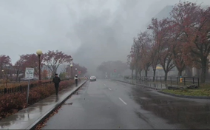
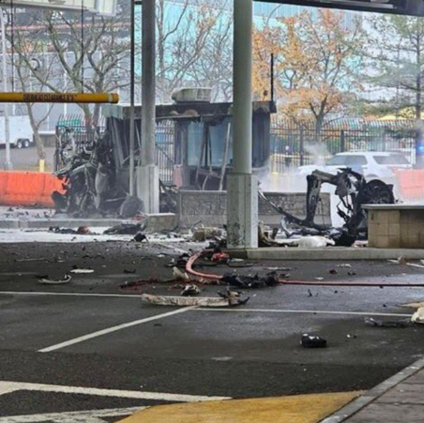



GOC OSINT
FA: USE CASE
Car Explosion – Rainbow Bridge, NY
The Dataminr AI Platform was first to detect the initial signals of a vehicle fire at the Rainbow Bridge border crossing
Clients received first signal from Dataminr 1 hour ahead of first coverage by major news sources
Within the first hour, Dataminr provided critical eyewitness accounts of the explosion enabling event awareness on both sides of US-CAN border
1 hour ahead
11:50 a.m. ET
Dataminr Signal, NY
First Major News reports of explosion
Aftermath of vehicle explosion at Rainbow Bridge
Actual Photo from
Dataminr Alert

Slide 9

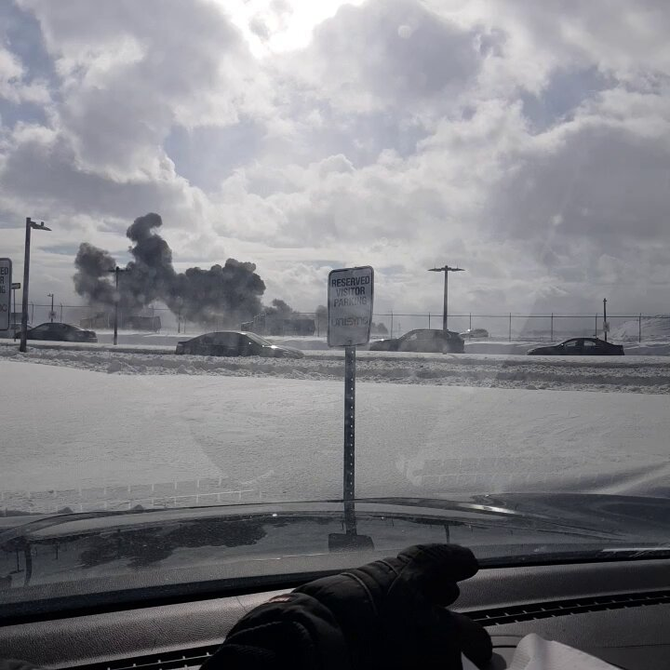
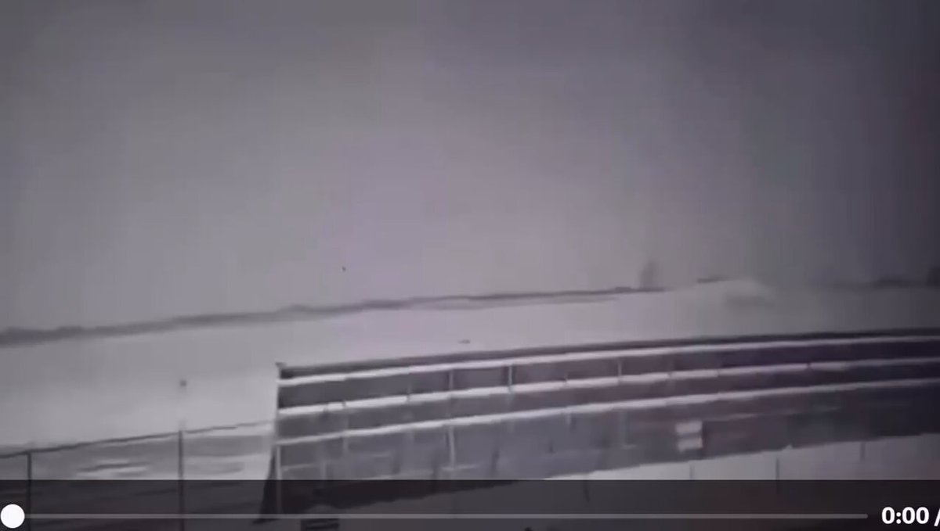

GOC OSINT
28 Unique Sources Include:
Sensor Data
Witness Video and Chatter
Local News and Blogs
Alternate Social Media & Public Telegram Board Posts
Government Notices
100
FA: USE CASE
Delta Airlines Plane Crash – Toronto, ON
Alert
6:36 PM Feb 17, 2025 Toronto, ON, CAN
Passengers evacuate Delta Air Lines Flight DL4819 plane at Toronto Pearson Airport in Canada: Witness Video via X.
8:12 PM Feb 17 2025 Toronto, ON, CAN
2:23 PM Feb 17 2025 Toronto, ON, CAN
Alert
Alert
Smoke rises from reported aircraft crash at Toronto Pearson Airport in Canada: Witness Video via X.
Possible footage of earlier aircraft crash at Toronto Pearson Airport in Canada shows Delta Air Lines flight skid on runway with smoke and fire: Blog Video via X.
Dataminr multi-modal AI fuses text, image, and video across multiple languages to produce real-time alerts
Dataminr® Proprietary Information. ©2025 All rights reserved.

Slide 10
OPEN PROJECT TOOL

Slide 11
OUR PATH FORWARD
GOC OSINT
DIRECTION
Invest in OSINT Capabilities
Develop and implement strategies to close information gaps and strengthen all-source analysis.
Government-Wide Initiatives
Actively participate in government-wide OSINT discussions through relevant working groups, aligning evolving OSINT needs with emergency management and consequence management strategies.
Enhance Training & Tradecraft
Establish ourselves as OSINT EM leaders within the federal emergency management community.
Our team's focus is on becoming experts in early warning and delivering timely, relevant situational awareness to our target audiences, all while maintaining strict adherence to our mandate.

Slide 12
GOC OSINT
THANK
YOU!
Thank you for your time.

Slide 13
GOC OSINT
PAGE 11
Presentation
ANNEXES

Slide 14
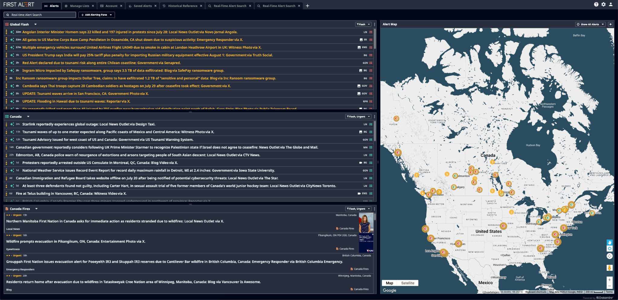
ANNEX
First Alert Platform
PAGE 12

Slide 15
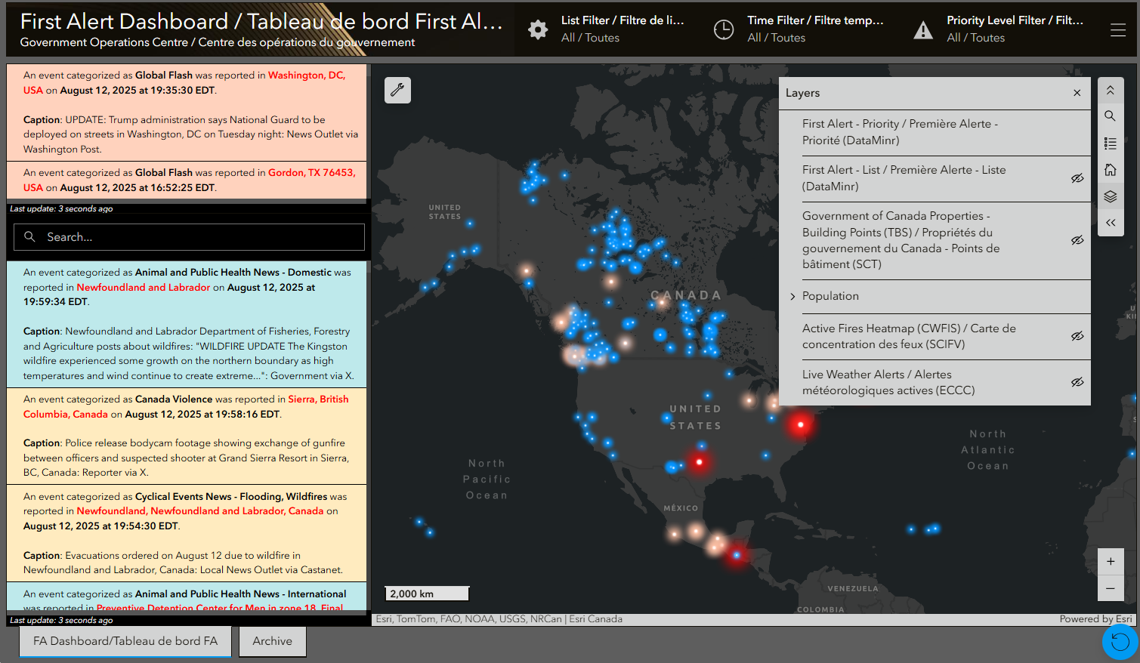
ANNEX
ESRI First Alert - GOC Dashboard
PAGE 14

